Slide 1
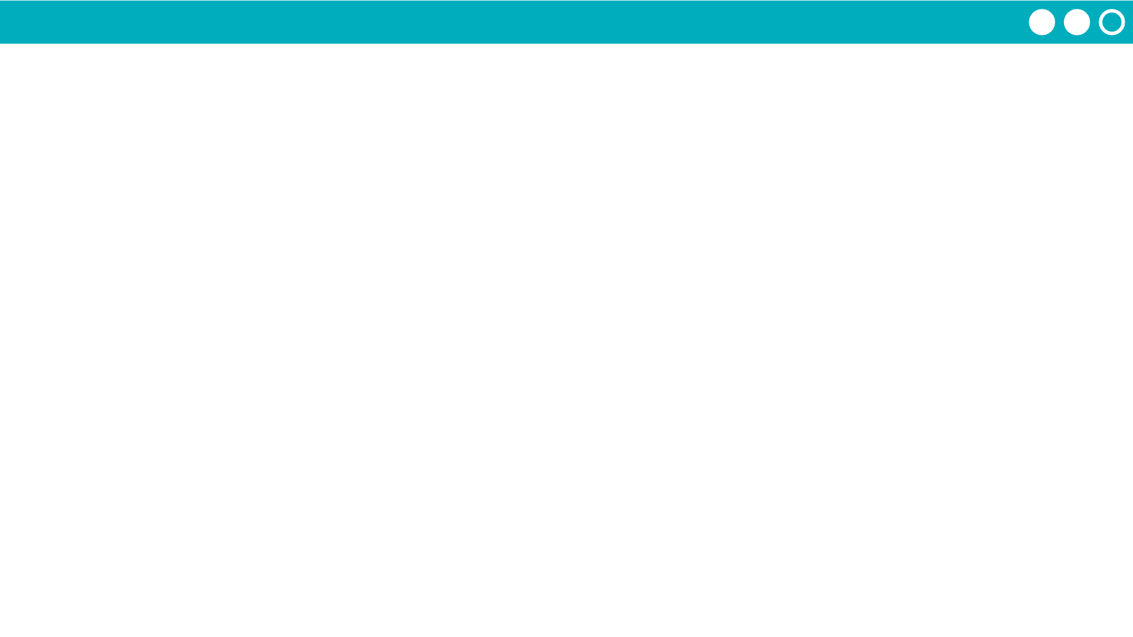
Unit 7 Lesson 9 - Activity
Step 6 - Improve
If you have time continue working on improving your library based on your feedback and testing from today

