Slide 1

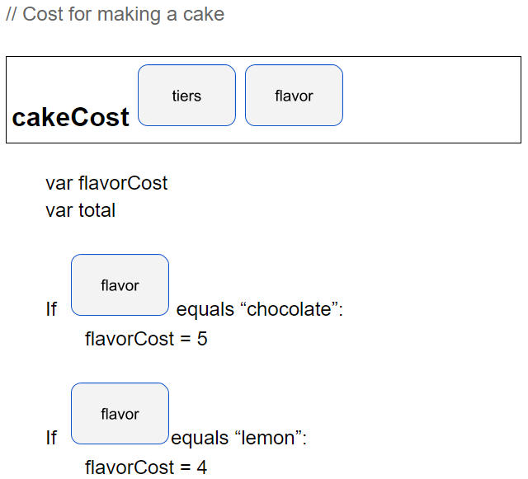
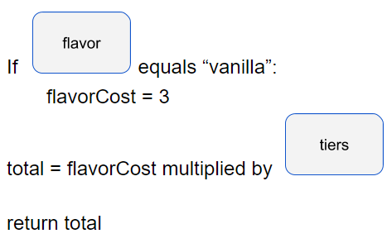
Unit 7 Lesson 1 - Activity
Create two new local variables, flavorCost and total.
Determine the value of flavorCost based on the argument passed through the flavor parameter
Calculate total using flavorCost and the argument passed through the tiers parameter
???????

