Slide 1

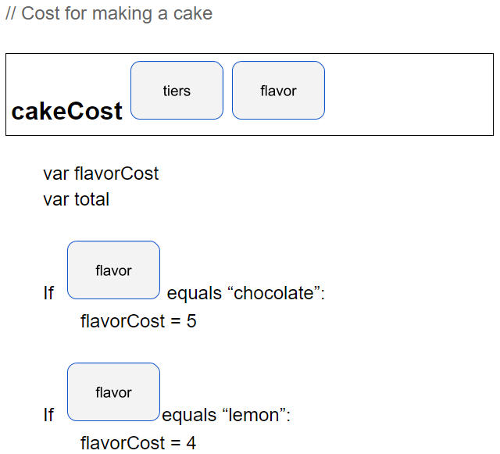
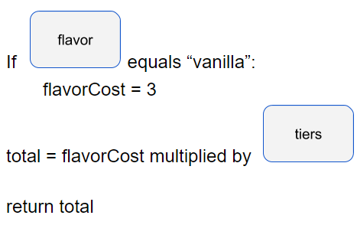
Unit 7 Lesson 1 - Activity
3
“lemon”
After running this, what does flavorCost equal?
What does total equal?
4
12

