Slide 1

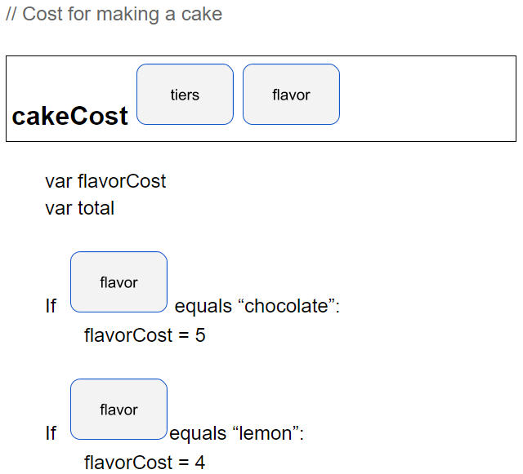
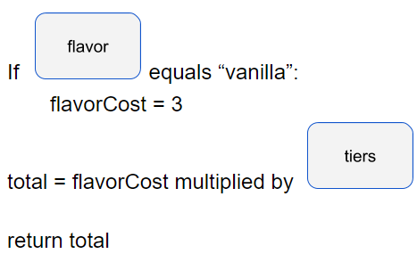
Unit 7 Lesson 1 - Activity
What does it mean to return total?
3
“lemon”
A return does two things:
It stops the flow of the function. If a return is inside of a conditional, if that condition is met the function ends there.
It returns a value to the place where the function was called.

