Slide 1
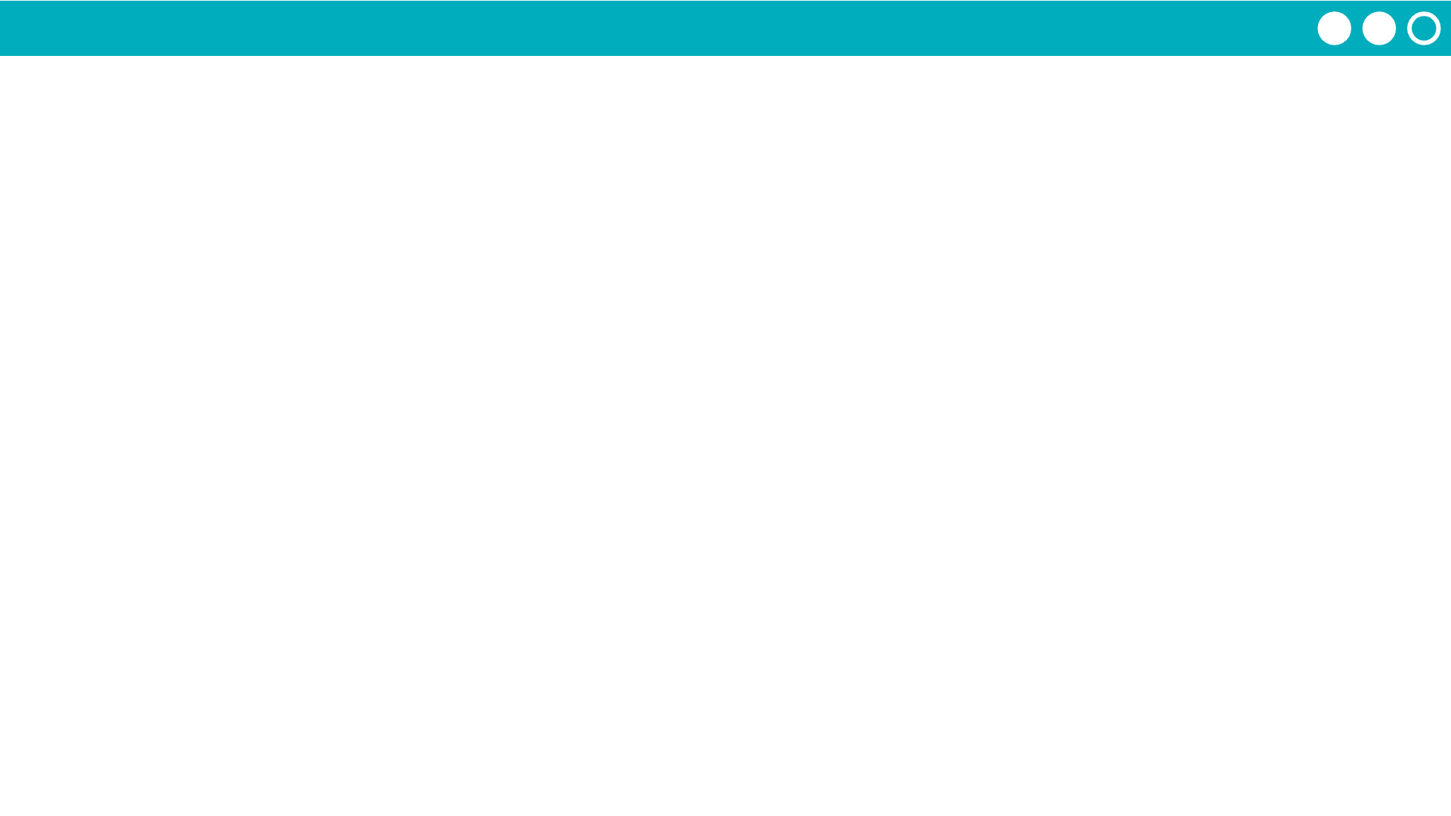
Unit 7 Lesson 1 - Activity
flavor
“lemon”
Let’s return to variable baggies!
A function return value can be stored in a variable.
tiers
11
12
cakeCost
cakeCalculator

