Slide 1

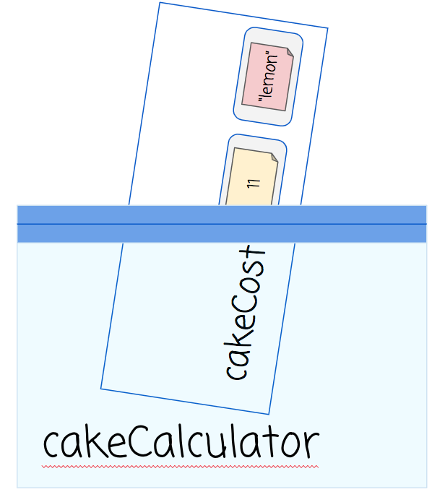
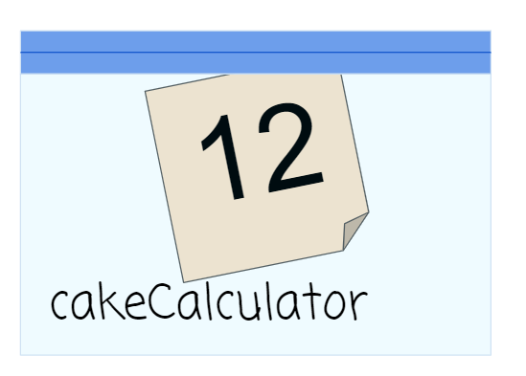
Unit 7 Lesson 1 - Activity
Here’s how this looks in Javascript:
var cakeCalculator = cakeCost(3, “lemon”);
After the expression is evaluated,
cakeCaculator stores the value 12.

