Slide 1

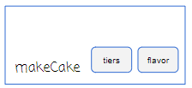
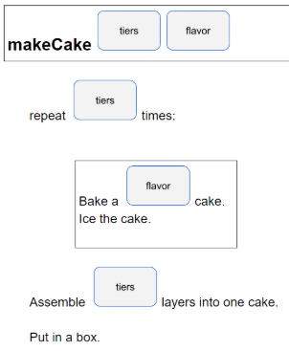
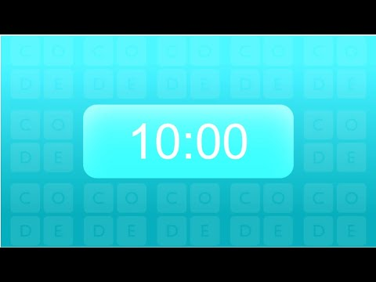
Unit 7 Lesson 1 - Activity
Do This: Create a cost calculator function for building the house you created a function for earlier.
Complete Challenge #2 on your Activity Guide

