Slide 1
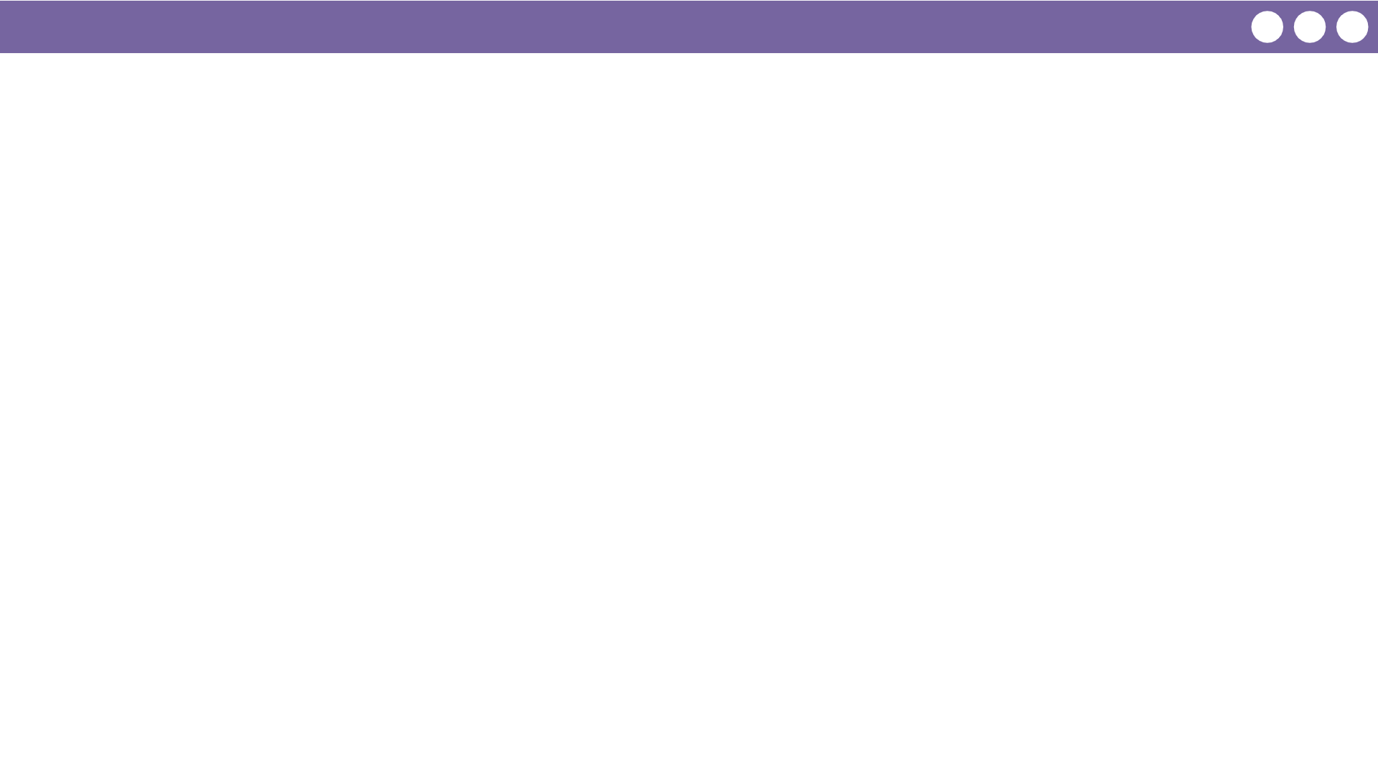
Unit 7 Lesson 1 - Wrap Up
Vocabulary
Parameter - a variable in a function definition. Used as a placeholder for values that will be passed through the function.
Argument - the value passed to the parameter
Return - used to return the flow of control to the point where the procedure (also known as a function) was called and to return the value of expression.

