Slide 1

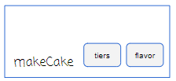
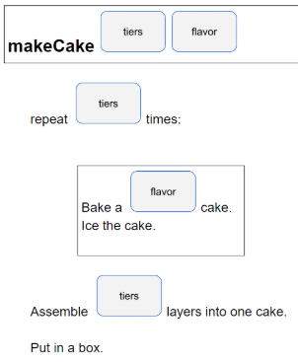
Unit 7 Lesson 2 - Activity
Review
Functions with parameters and return values help us simplify our code
Functions can only return one value at a time
A function can have:
No parameters and no return values
Parameters, but no return values
Return values, but no parameters
Parameters and return values

