Slide 1

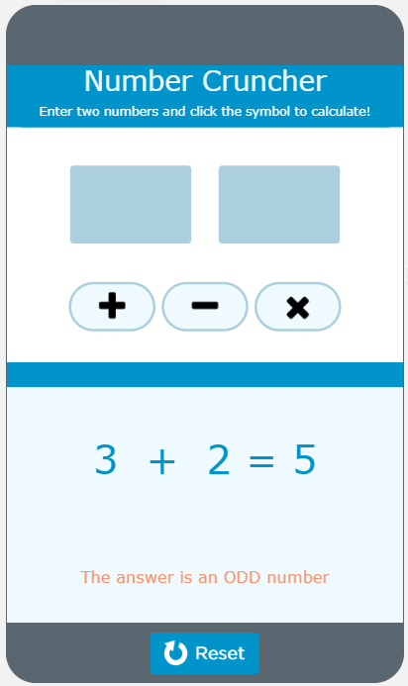
Unit 7 Lesson 2 - Activity
Do This:
Find a partner
Navigate to Level 1
Read the program with your partner
Respond to all the questions for your app
Be ready to share your responses and what you learned with the class.

