Slide 1
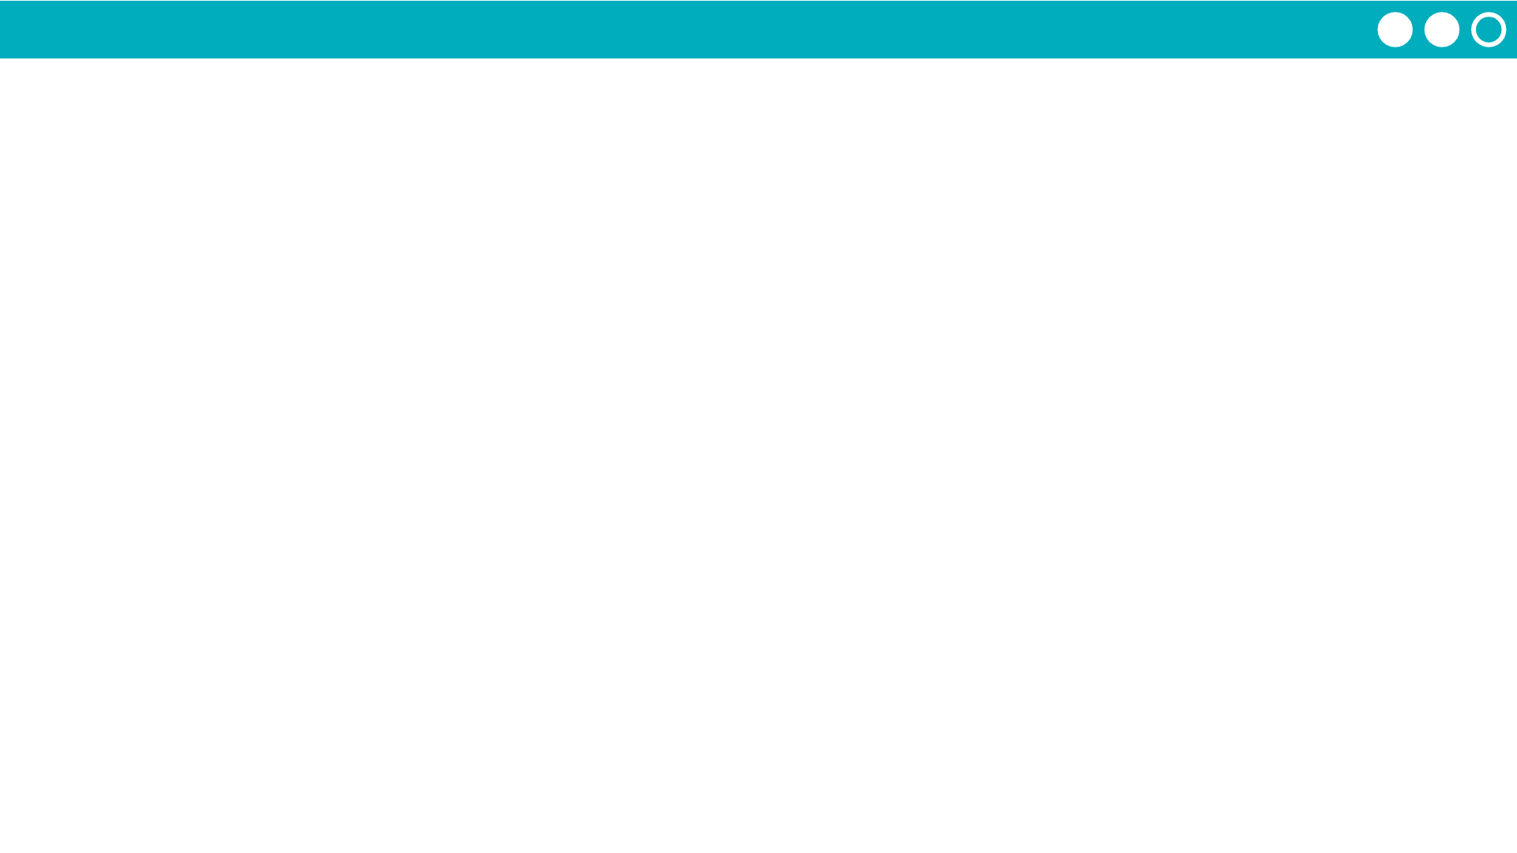
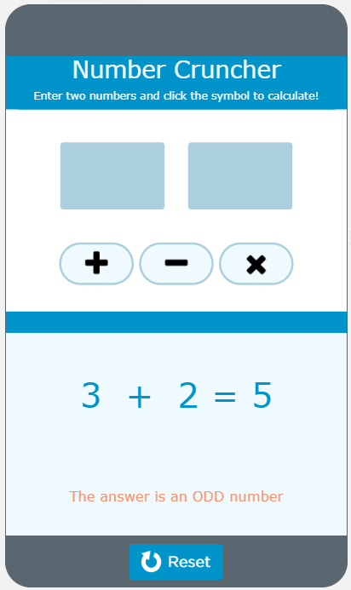
Unit 7 Lesson 2 - Activity
Discuss as a class:
How does calculate(symbol) work?
What is the parameter?
What is the argument?
What is returned?

