Slide 1

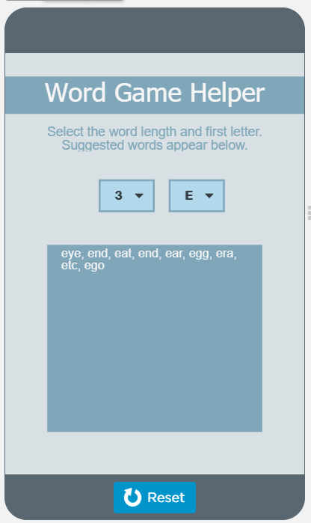
Unit 7 Lesson 2 - Activity
Do This:
With your partner:
Navigate to Level 2
Read lines 1-14
What is happening here?
Be prepared to discuss as a class.

