Slide 1
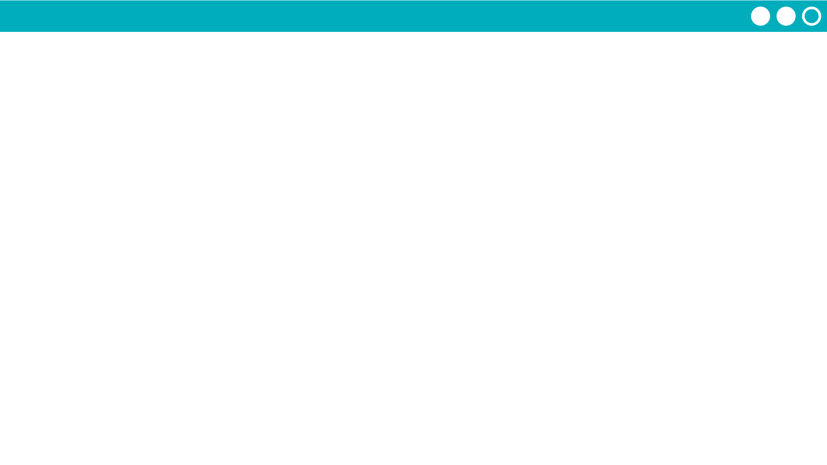
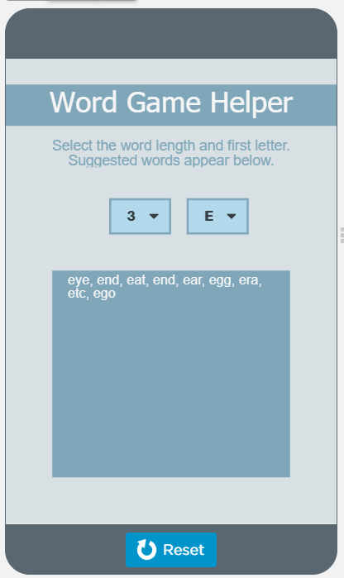
Unit 7 Lesson 2 - Activity
Do This:
Now, read the function on lines 15-34 carefully. After you are done, explain to your partner how the function works, what parameters it takes and what is returned.
Extra time? Complete the modify.

