Slide 1

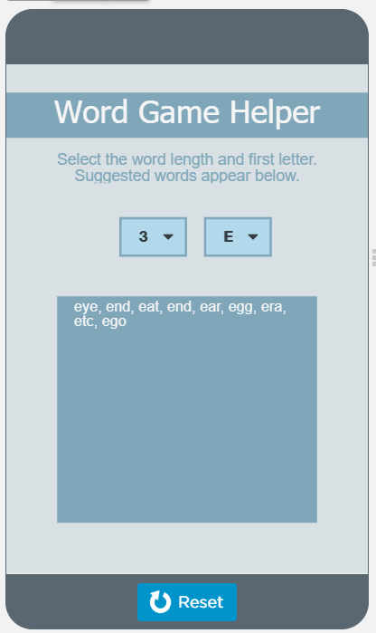
Unit 7 Lesson 2 - Activity
Discuss as a class:
How does the Word Game Helper work?

