Slide 1
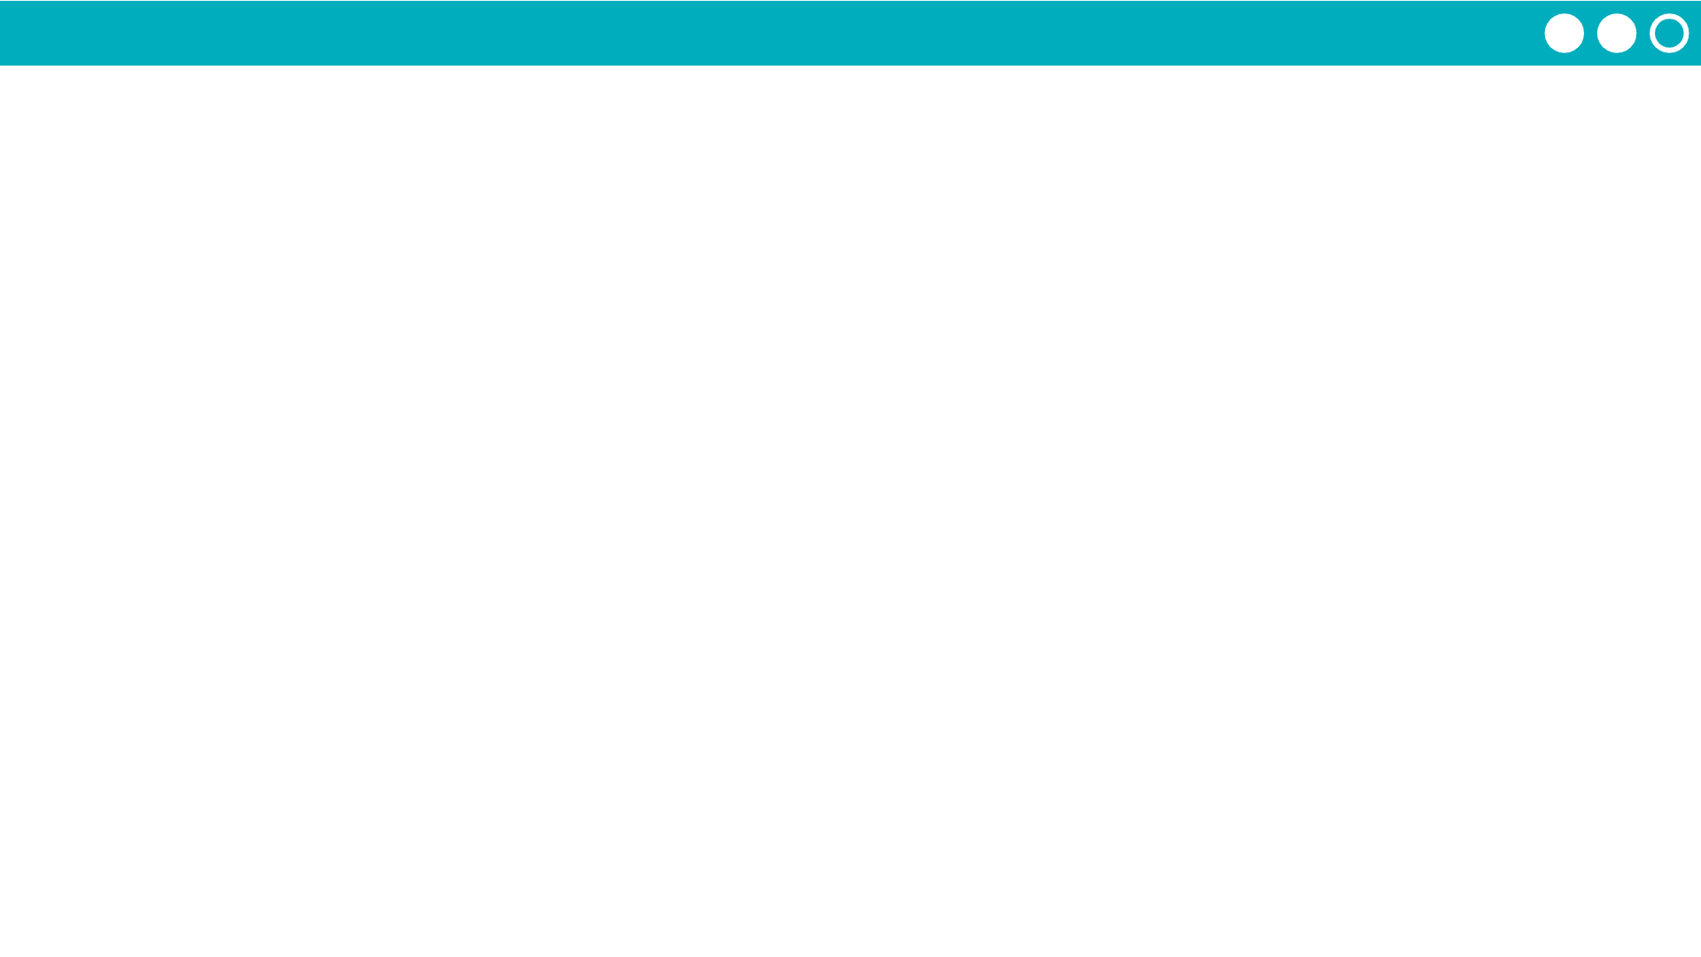
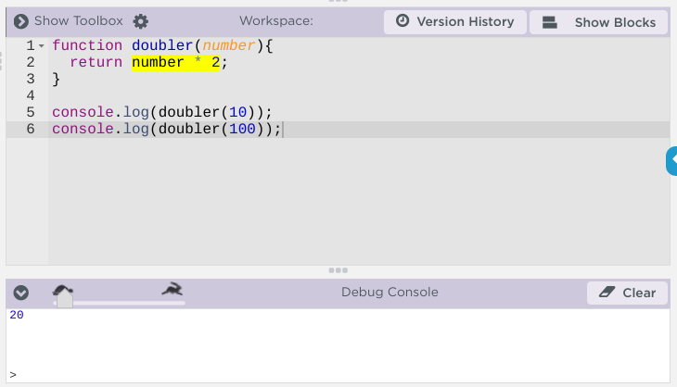
Unit 7 Lesson 3 - Activity
Debugging Functions with Parameters and Return
Use the speed slider to slow down code so you can watch how functions are being called. This will highlight lines of code in yellow as the program runs.
Use console.log to call functions with parameters and see how calling them with different values returns different values

