Slide 1
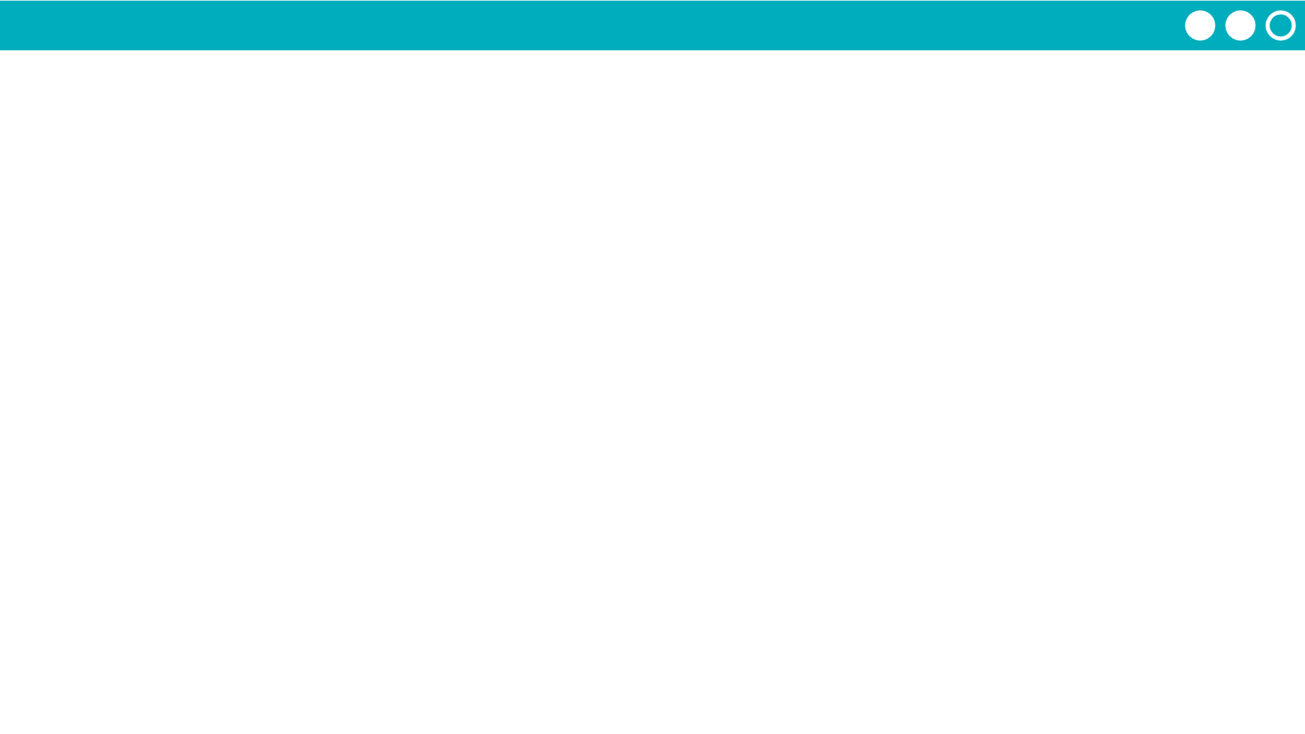
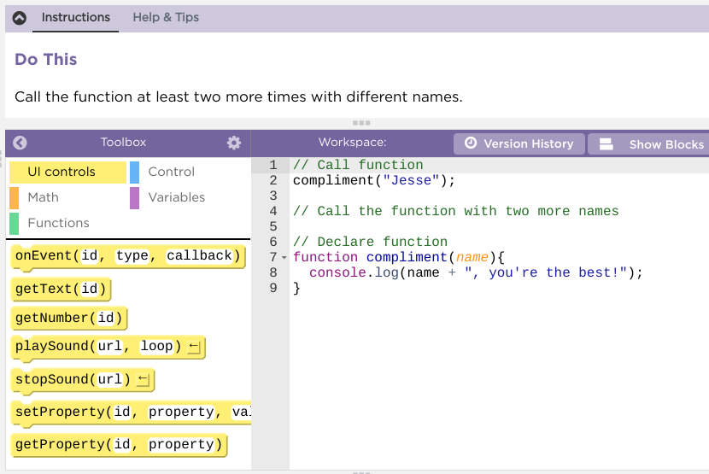
Unit 7 Lesson 3 - Activity
Parameters and Return Practice
Do This:
Navigate to Lesson 3, Level 1 on Code Studio

