Slide 1
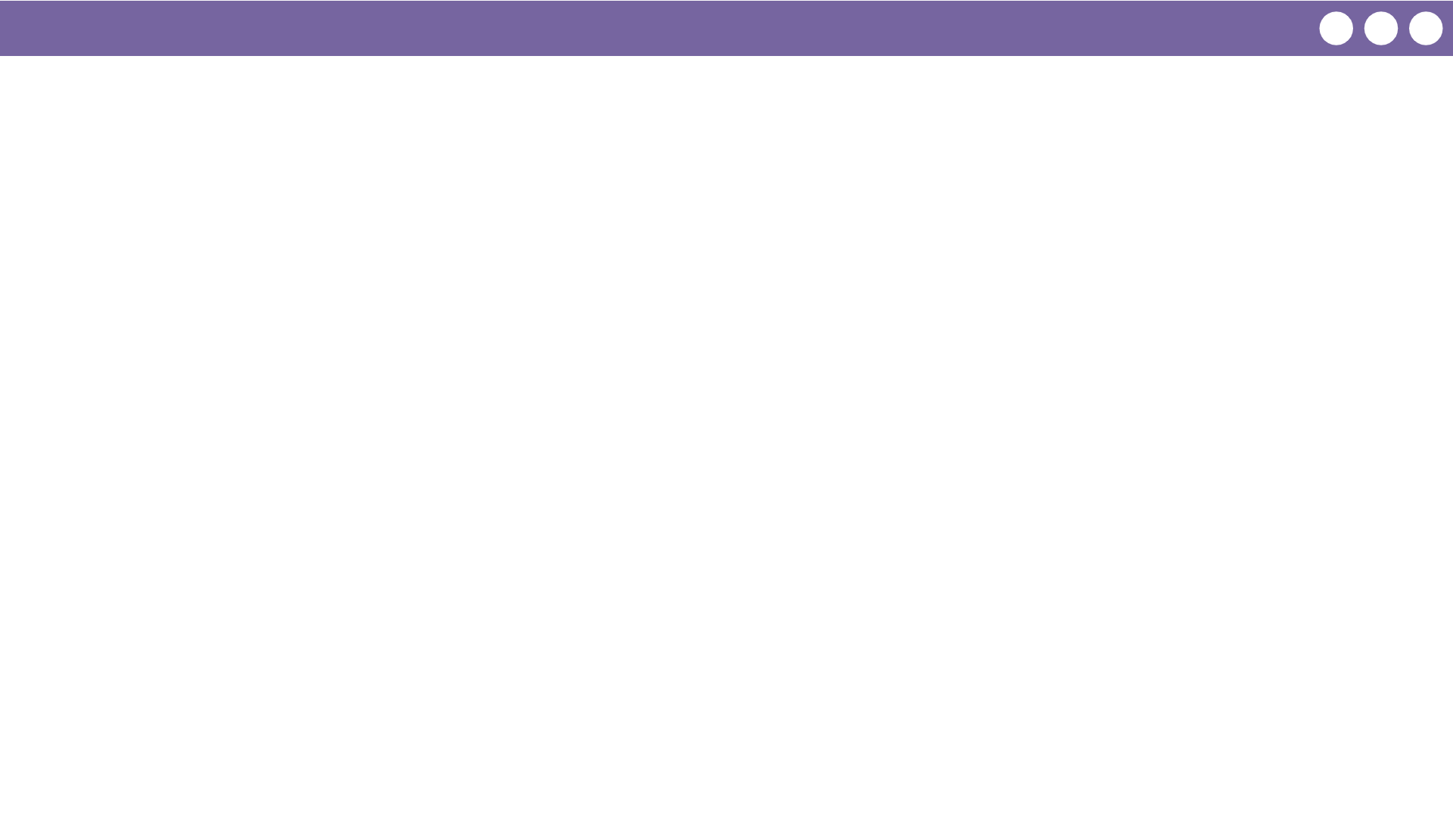
Unit 7 Lesson 3 - Wrap Up
Prompt:
What aspects of working with parameters and return values do you feel like clicked today?
What do you still feel like you have trouble with?

