Slide 1
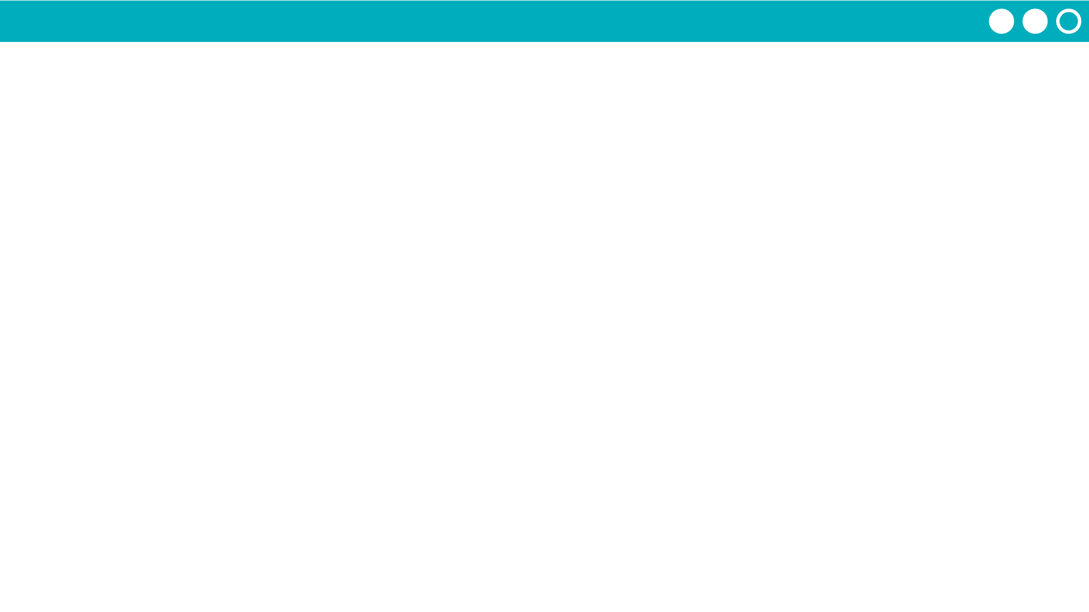
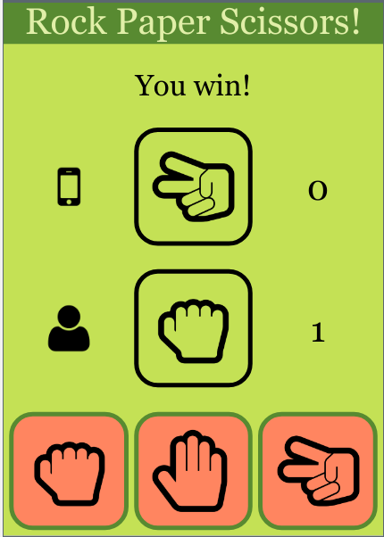

Unit 5 Lesson 4 - Activity
Parameters and Return Make:
Rock Paper Scissors App
Do This:
Navigate to Lesson 4, Level 1 on Code Studio

