Slide 1

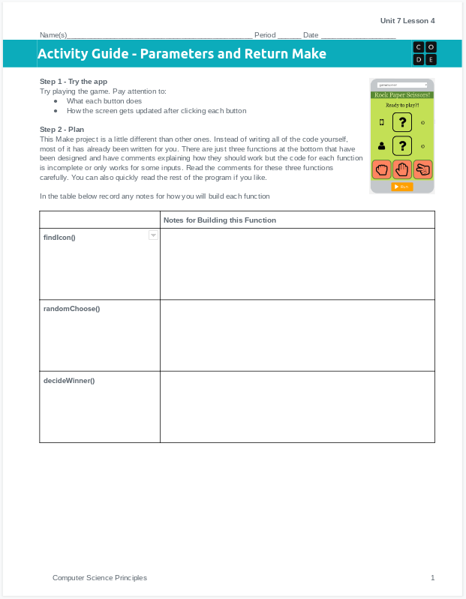
Unit 5 Lesson 4 - Activity
Do This: Make the Rock Paper Scissors App!
Use the activity guide to plan out your code.
Don't forget you're only working inside of the three functions at the bottom of the program. Use programming patterns to help and test your code as you go.
Step 3 includes steps you can follow to build the app, or you can use your own process.

