Slide 1

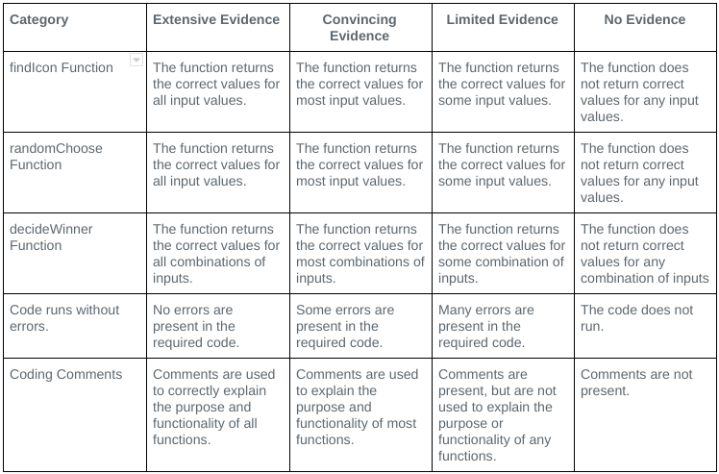
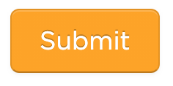
Unit 5 Lesson 4 - Activity
Don't forget: check the rubric on the last level before hitting submit

