Slide 1
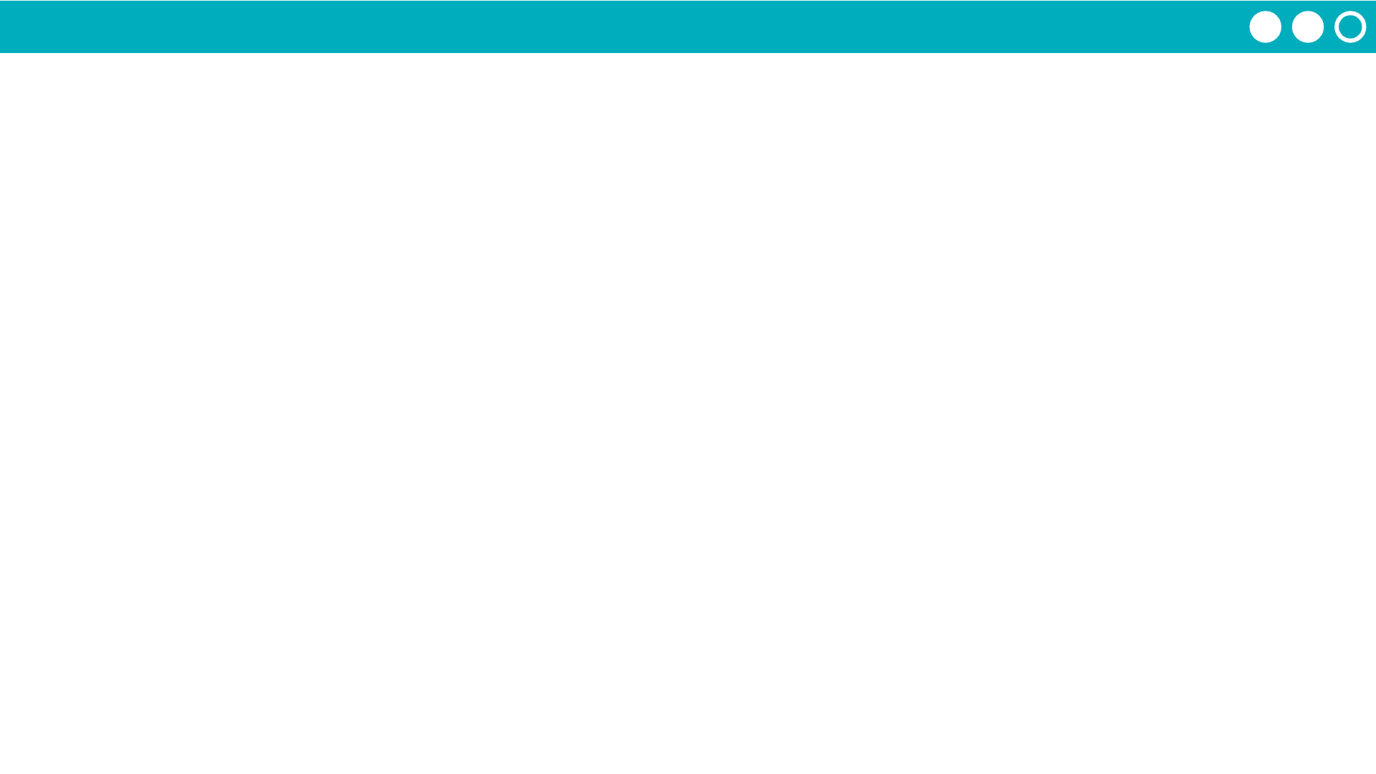
Unit 7 Lesson 5 - Activity
Have you ever wanted to share some of your code with a friend so they can use it to add a cool feature in their own program?
Or maybe you’ve got a collection of functions in one program that you want to use in another program.
How can we easily share functions between programs?

