Slide 1
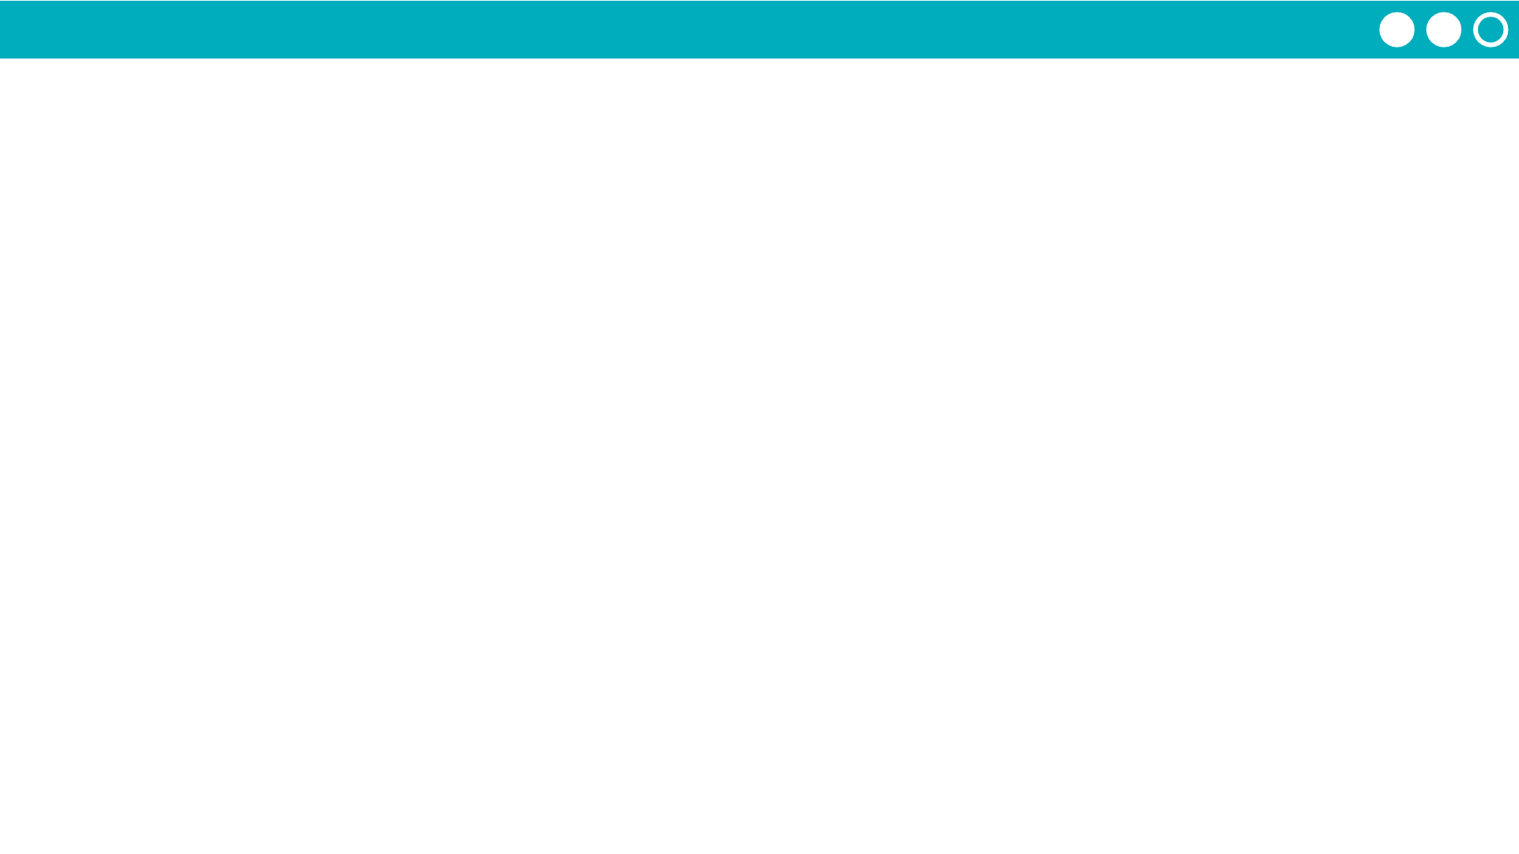
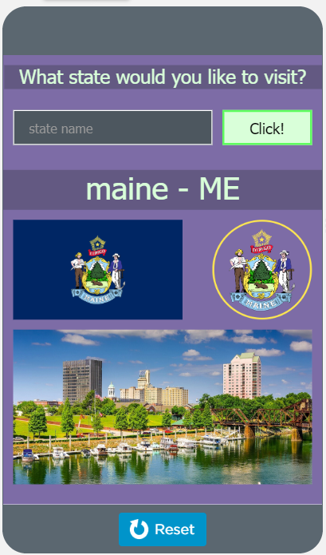
Unit 7 Lesson 6 - Activity
Discuss:
With a partner, look at the project code.
Discuss what happens when the button is clicked.

