Slide 1

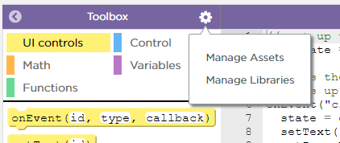
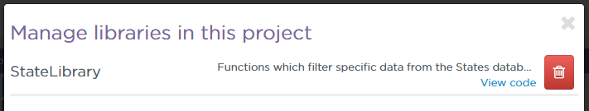
Unit 7 Lesson 6 - Activity
Do This:
Click "Manage Libraries"
Click "view code" for the State Library
With your partner, read through the library and discuss how the functions work. Were you accurate in your predictions?

