Slide 1

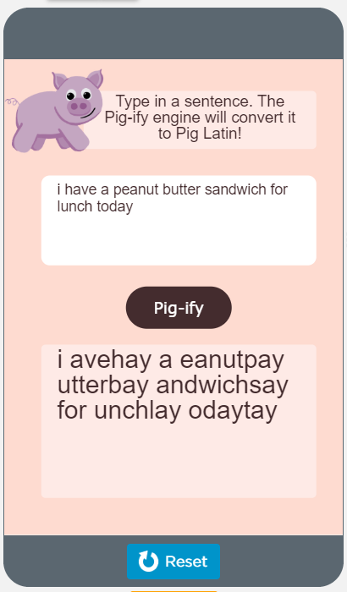

Unit 7 Lesson 6 - Activity
Do This:
Navigate to Level 2
Run the app
Try several different inputs

