Slide 1

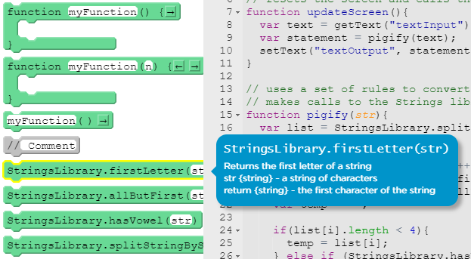
Unit 7 Lesson 6 - Activity
Do This:
Open the functions drawer
Look at each of the StringsLibrary functions. Mouseover for the documentation.
Discuss with a partner how you think these functions work.

