Slide 1
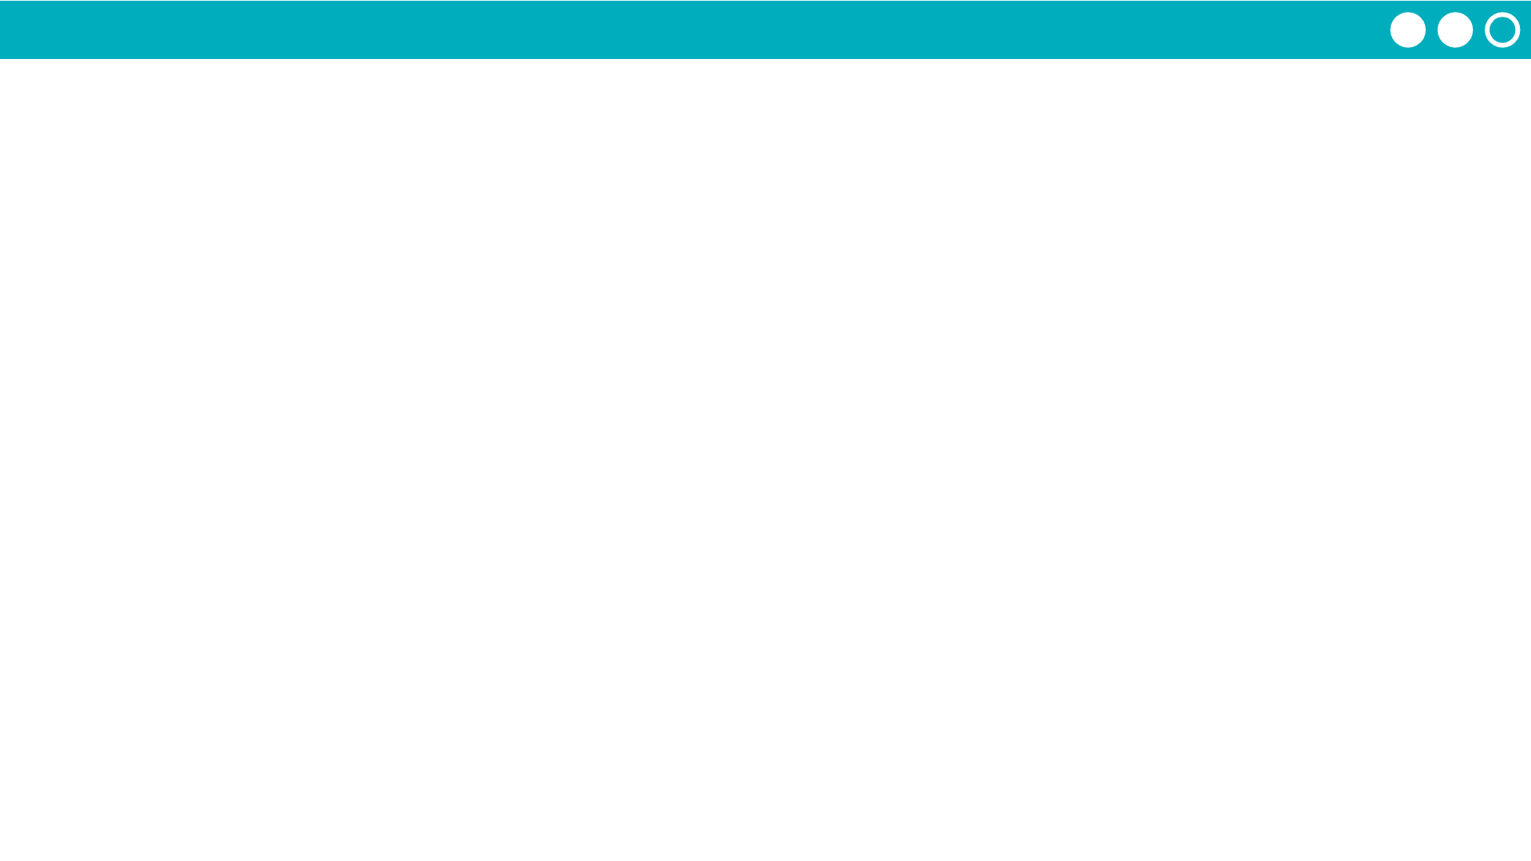
Unit 7 Lesson 6 - Activity
Prompt:
Why should we test the functions in the library? What does this help us to know?

