Slide 1
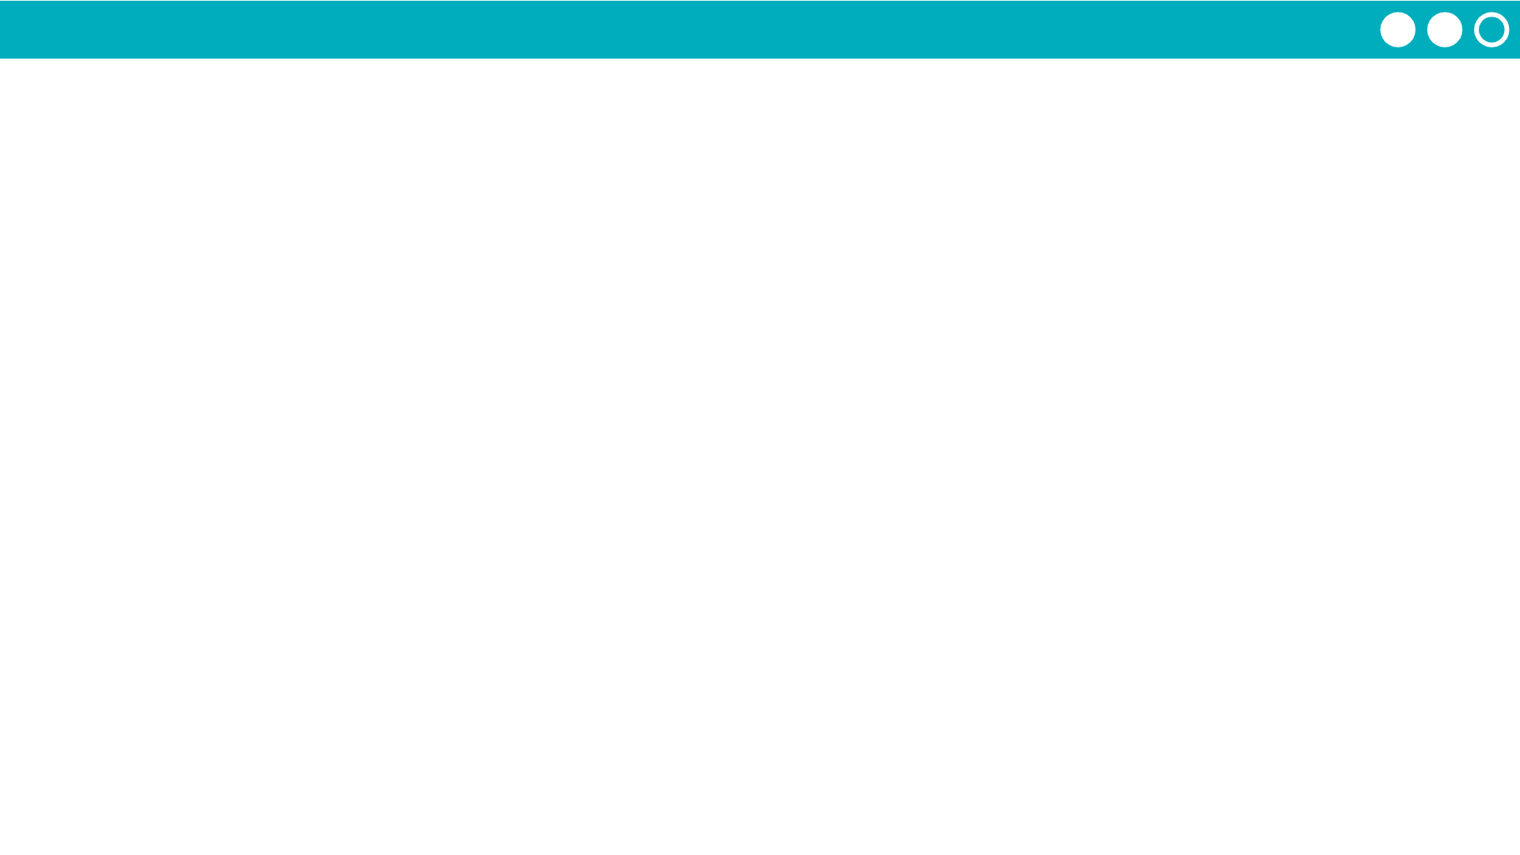
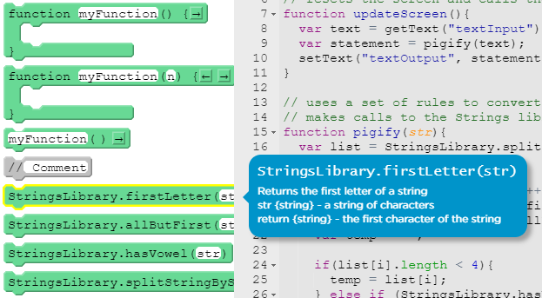
Unit 7 Lesson 6 - Activity
Takeaways:
Creating a library:
Build functions
Add documentation
Share as a Library
Using a library:
Click "Manage Libraries"
Either choose a classmate's library, or paste in a library code
Call the functions by writing the library name, a dot, the name of the function, and including any arguments for the parameters
Testing a library:
Use console.log as the end user to test functions in a library
Check that the output is what you would expect
Read the library code if something does not work correctly, and contact the library owner if something needs to be changed.

