Slide 1
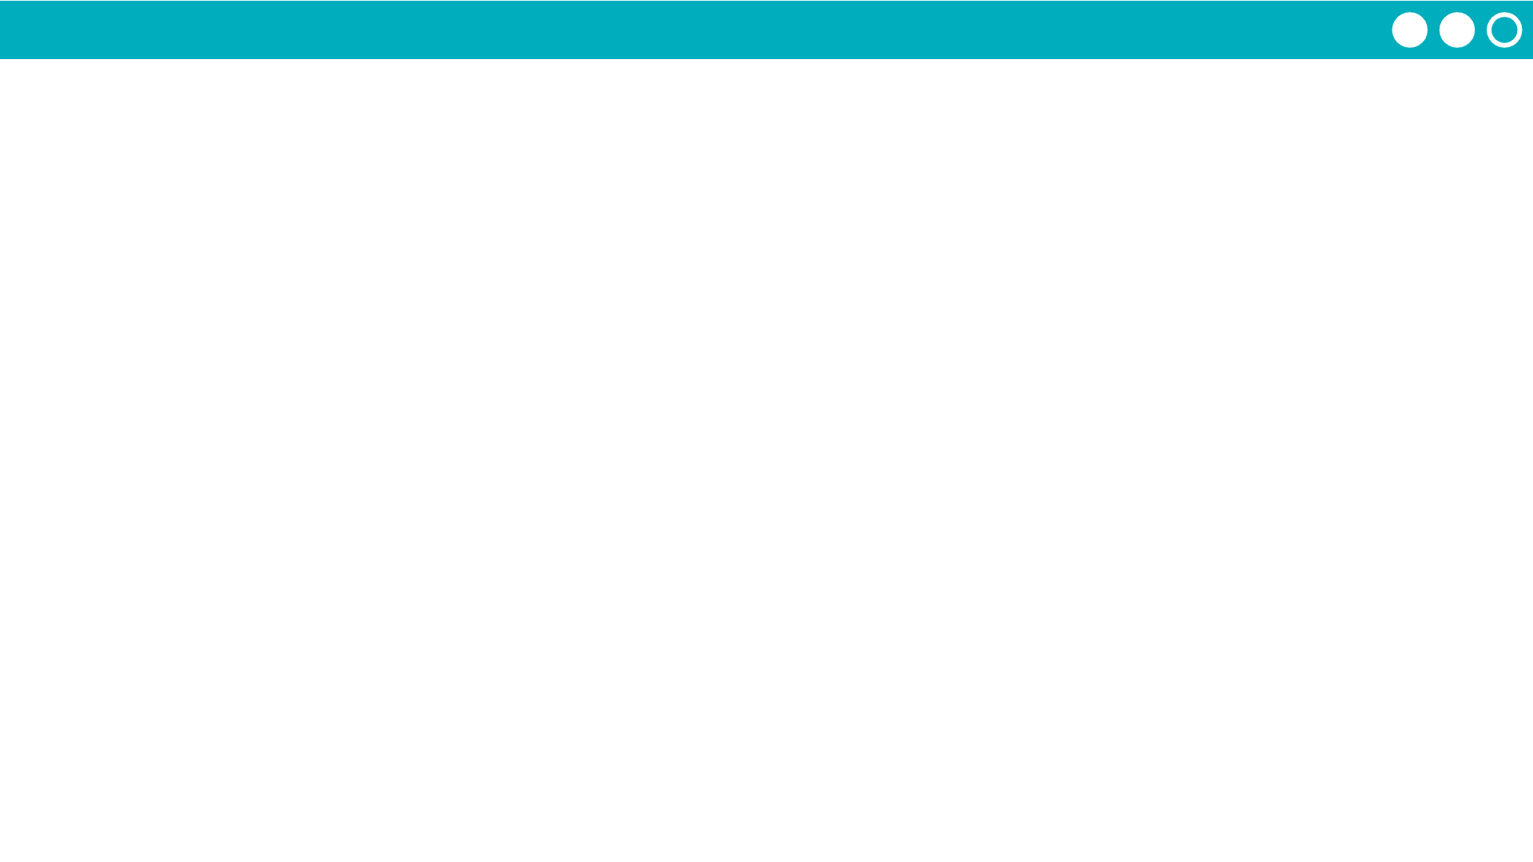
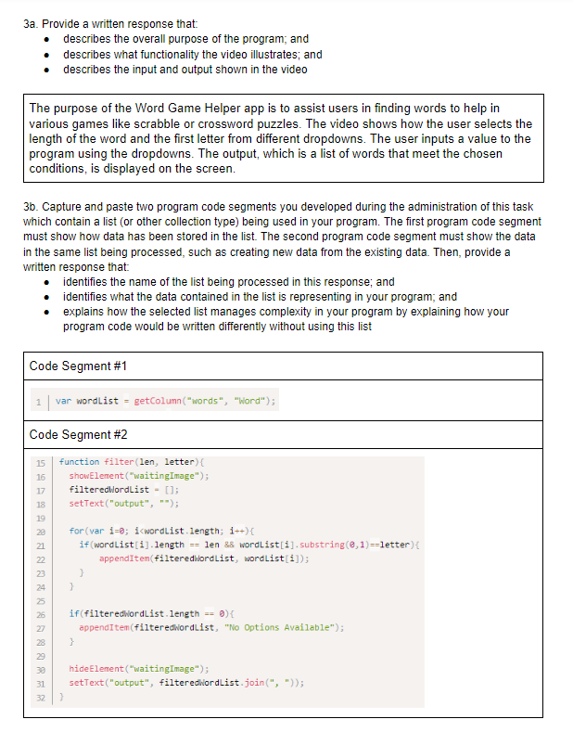
Unit 8 Lesson 1 - Activity
Prompt:
This is a Written Response for the Create PT. Read it to yourself first. Then with your partner spend a few minutes reviewing it.
Be ready to share out the following answers:
Did anything surprise you in looking at this sample?
Do you think this scored well based on what you know about the scoring guidelines?

