Slide 1

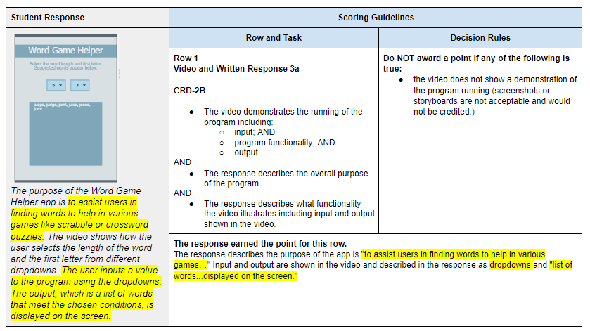
Unit 8 Lesson 1 - Activity
Distribute:
Create PT
Annotated Sample 1

