Slide 1

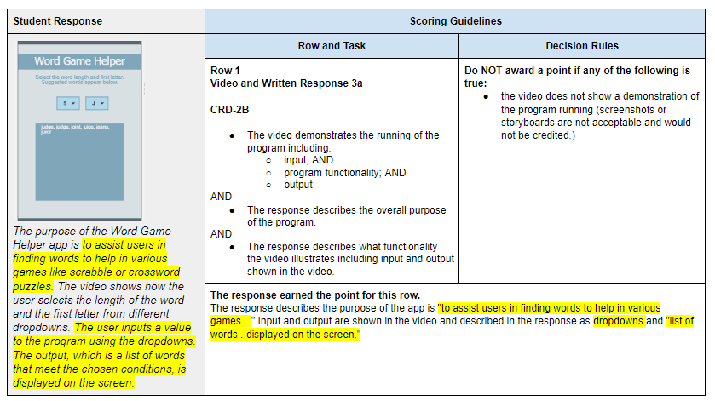
Unit 8 Lesson 1 - Activity
Prompt:
With your partner look over this annotated version of the sample to see how each row of the scoring guidelines was applied. You should be reading specifically to answer any of the questions you had about the task earlier.
After looking it over we will discuss:
What characteristics of this response made it score well?
What parts confused you?
What questions do you still have about the Scoring Guidelines or Task description?

