Slide 1

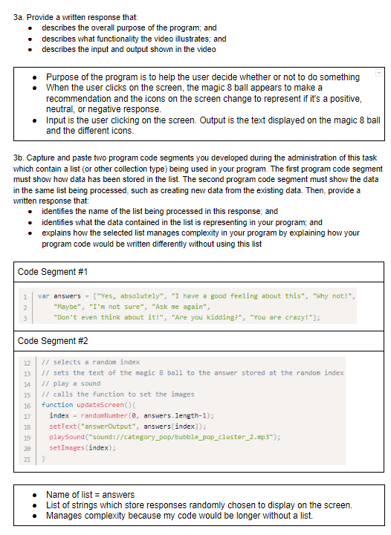
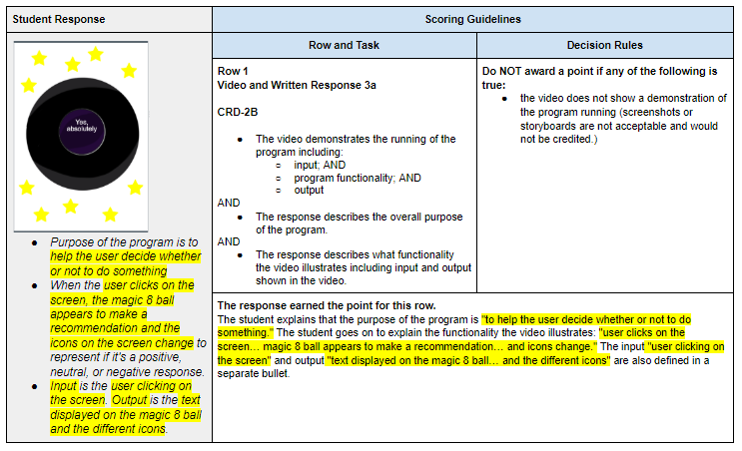
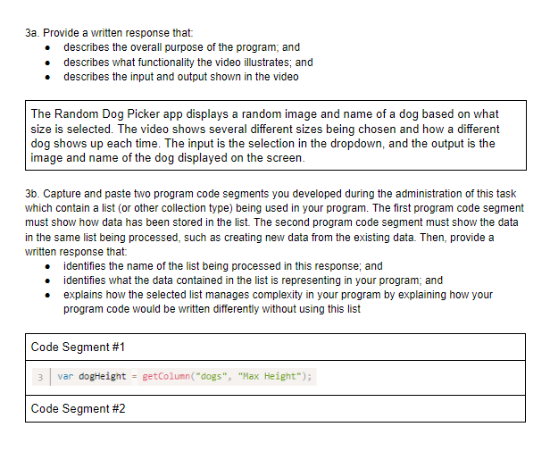
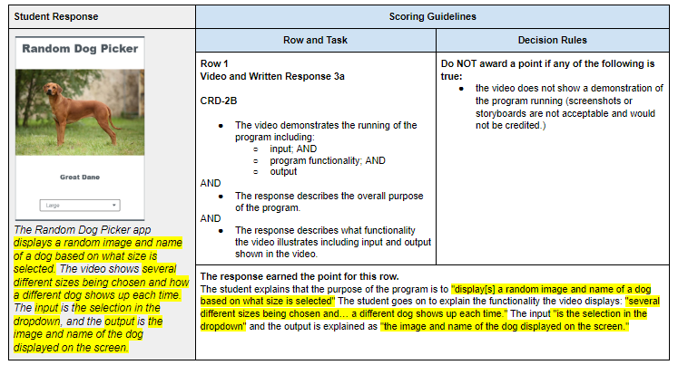
Unit 8 Lesson 1 - Activity
Distribute:
Create PT Annotated Sample 2
Create PT Written Response Sample 2
Create PT Annotated Sample 3
Create PT Written Response Sample 3

