Slide 1

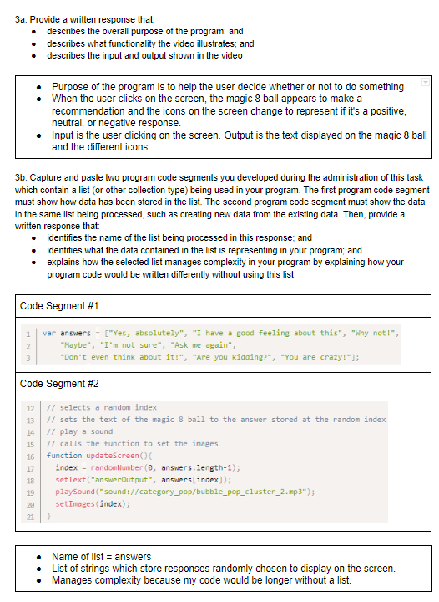
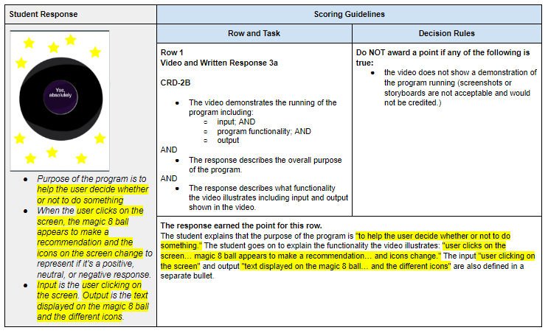
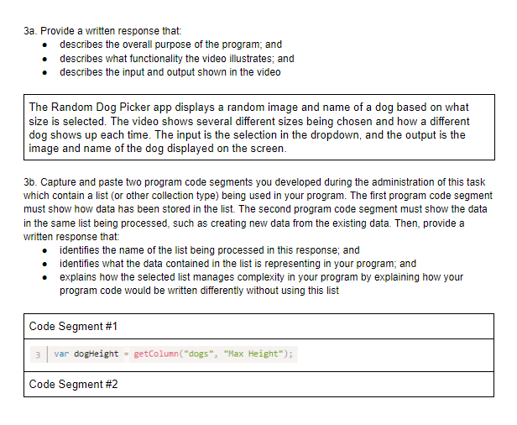
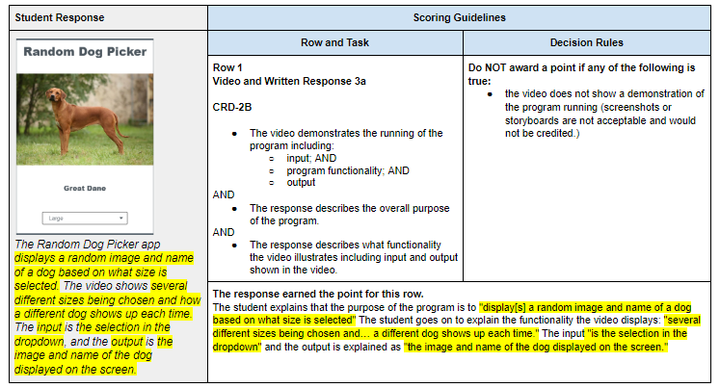
Unit 8 Lesson 1 - Activity
Prompt:
With your partner, look at these samples - you can pick which to look at first. As you review this task with a partner ask yourself:
Where an how specifically did this fall short?
Was there one major problem that caused ripple effects through the scoring?
Or were there several smaller issues?
Try to point out specific aspects of the Scoring Guidelines or Submission Requirements.

