Slide 1

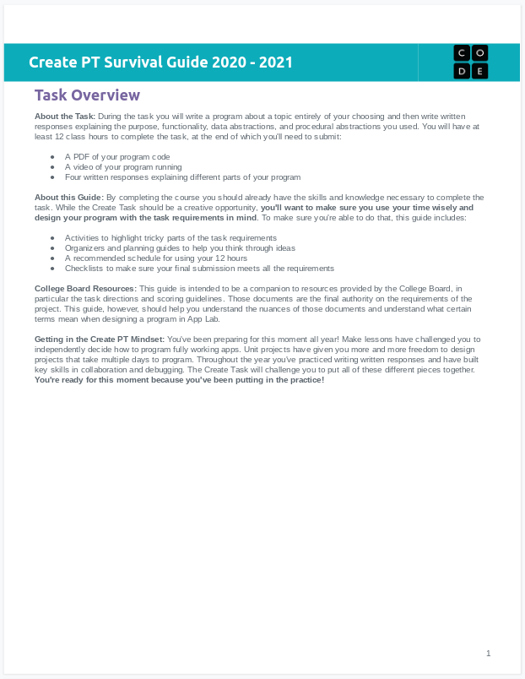
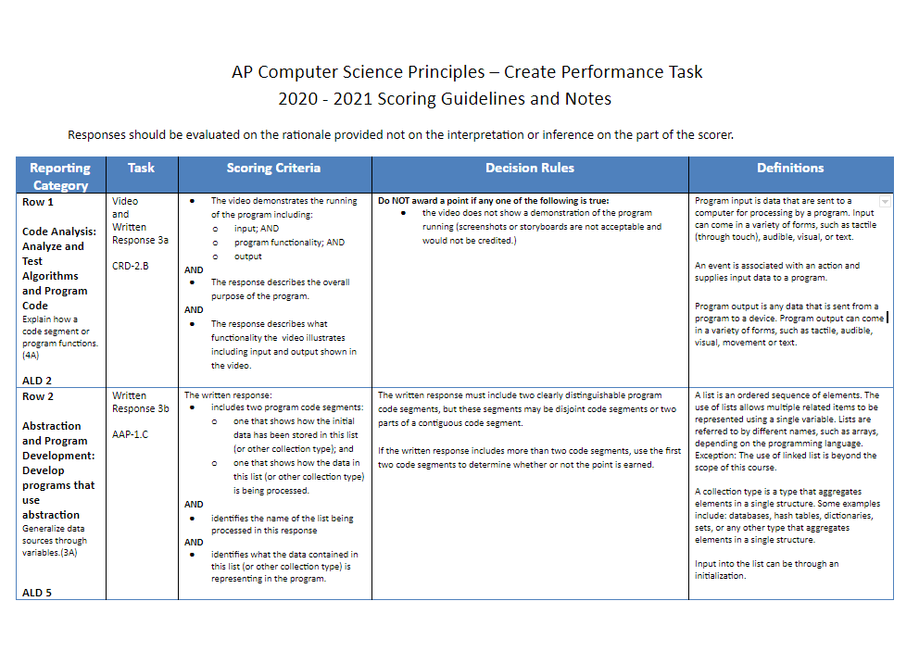
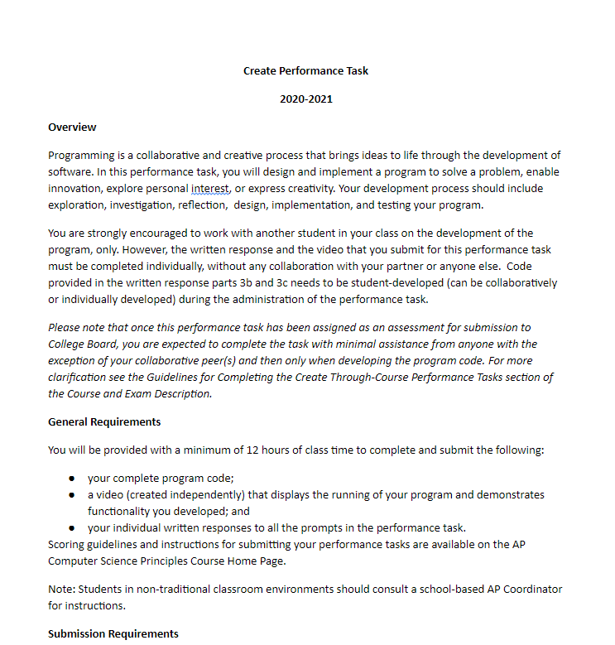
Unit 8 Lesson 2 - Activity
What you'll need:
Create PT Survival Guide
(Optional)
Task Directions
Scoring Guidelines

