Slide 1
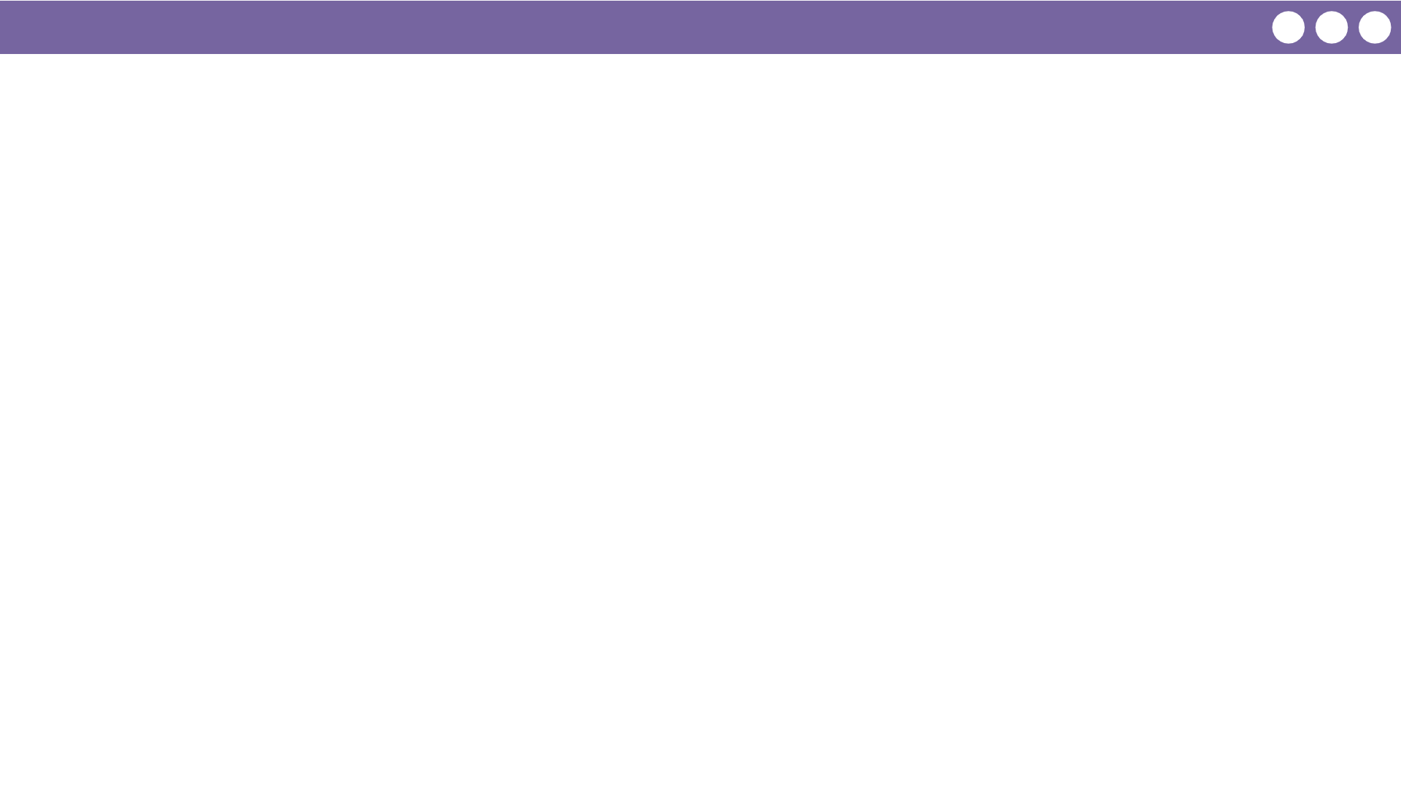
Unit 8 Lesson 2 - Wrap Up
Today was focused on understanding the requirements for the function you write about in response 3c.
Prompt:
What aspects of writing functions for the Create PT do you feel clicked today?
What do you still have questions about?

