Slide 1

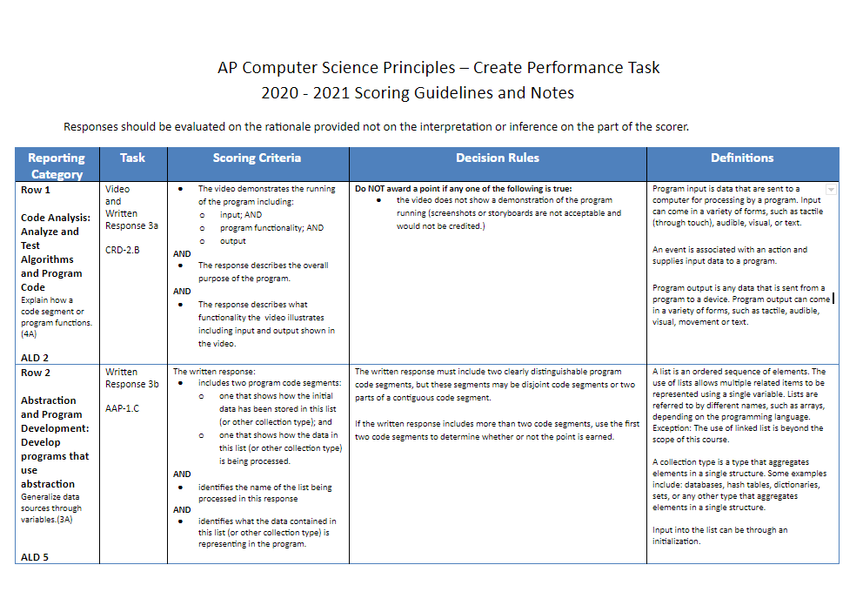
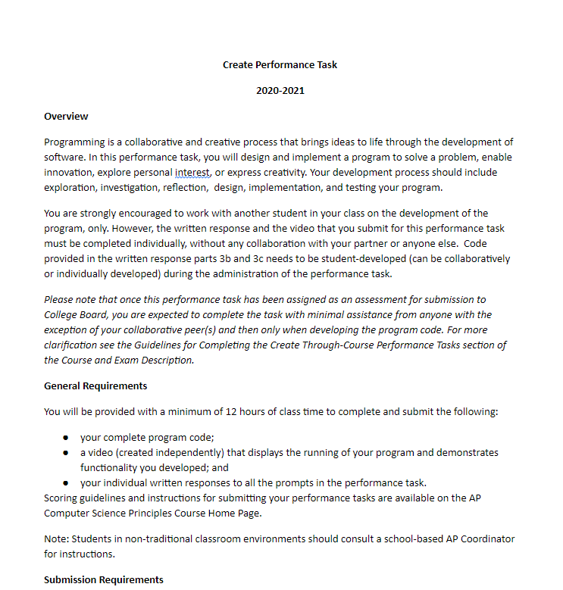
Unit 8 Lesson 1 - Warm Up
Distribute:
Scoring Guidelines
Task Instructions

