Slide 1

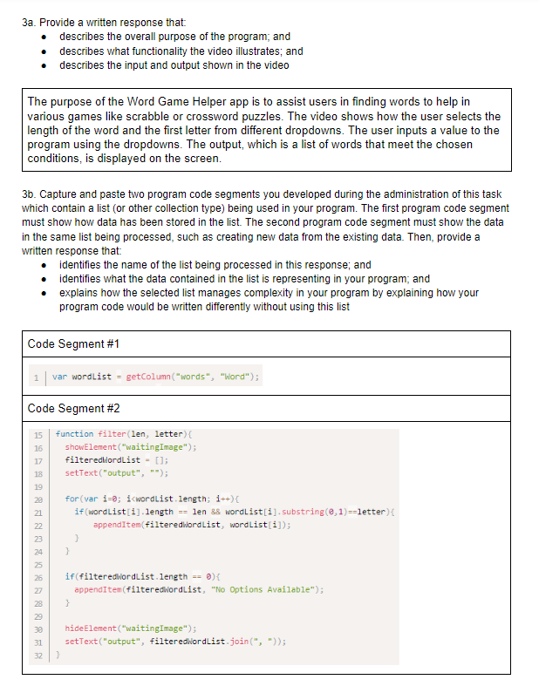
Unit 8 Lesson 1 - Activity
Distribute:
Create PT Sample 1
Written Response

