Slide 1

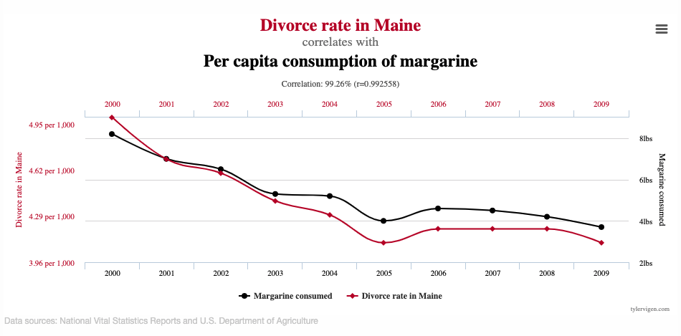
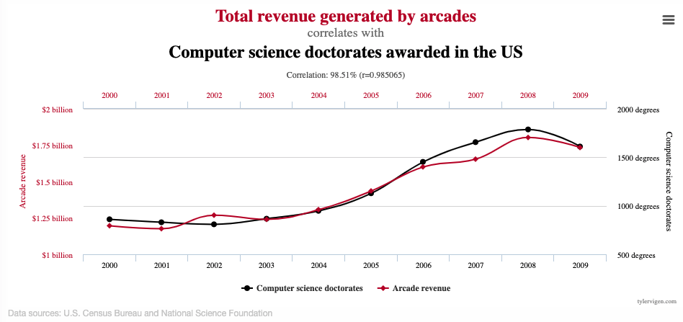
Unit 9 Lesson 1 - Activity
Correlation does not equal Causation
similarities, patterns
this thing caused that thing
Notes:
Graphs: https://www.tylervigen.com/spurious-correlations

