Slide 1


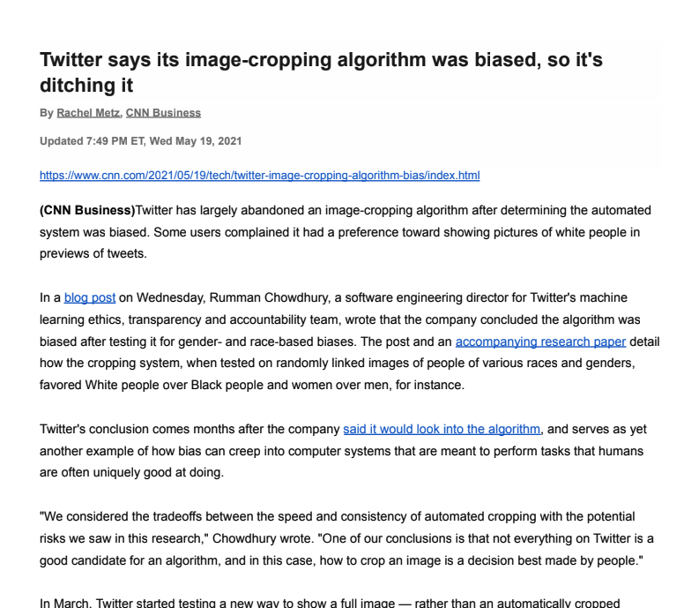
Unit 9 Lesson 7 - Activity
Twitter Cropping Algorithm
You should have:
A copy of the article
Pens or pencils

