Slide 1

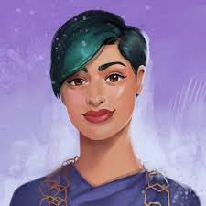
Unit 9 Lesson 7 - Wrap Up
This release reduces our dependency on ML for a function that we agree is best performed by people using our products.
One of our conclusions is that not everything on Twitter is a good candidate for an algorithm, and in this case, how to crop an image is a decision best made by people.
Even if the saliency algorithm were adjusted to reflect perfect equality across race and gender subgroups, we’re concerned by the representational harm of the automated algorithm when people aren't allowed to represent themselves as they wish on the platform.
Rumman Chowdry
software engineering director for Twitter’s machine learning ethics, transparency, and accountability team
Do you think Twitter’s response was appropriate?
What are the risks and potential harms of systems, such as social media platforms like Twitter, becoming too dependent on machine learning?
Prompts:
Notes:
Source: https://blog.twitter.com/engineering/en_us/topics/insights/2021/sharing-learnings-about-our-image-cropping-algorithm

