Slide 1

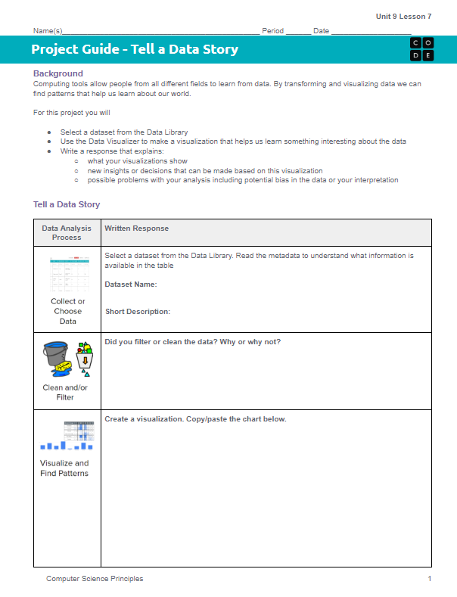
Unit 9 Lesson 8 - Activity
Project - Tell a Data Story
Do This: Today you are working on Page 1 of the Project Guide that covers these steps of the Data Analysis Process:
Choose or Collect Data
Clean and/or filter
Visualize and Find Patterns

