Slide 1

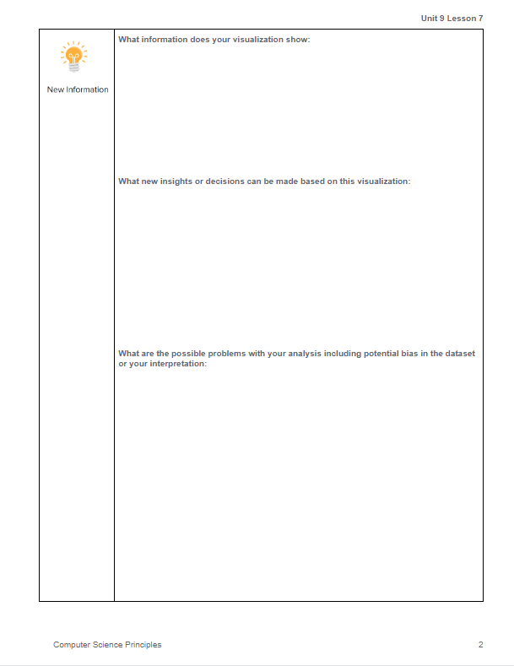
Unit 9 Lesson 9 - Activity
Project - Tell a Data Story
Do This: Today you are working on Page 2 of the Project Guide that covers this step of the Data Analysis Process:
New Information

