Slide 1

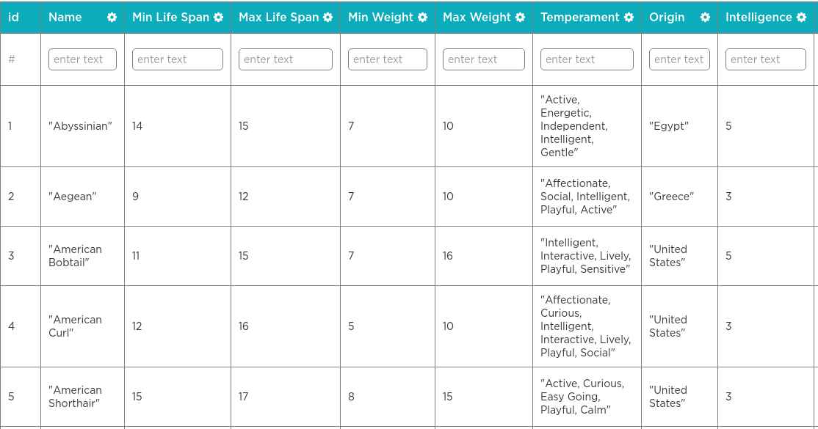
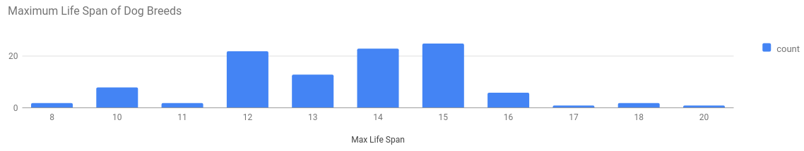
Unit 9 Lesson 2 - Warm Up
Prompt:
Why do people make visualizations out of data?
?

