Slide 1

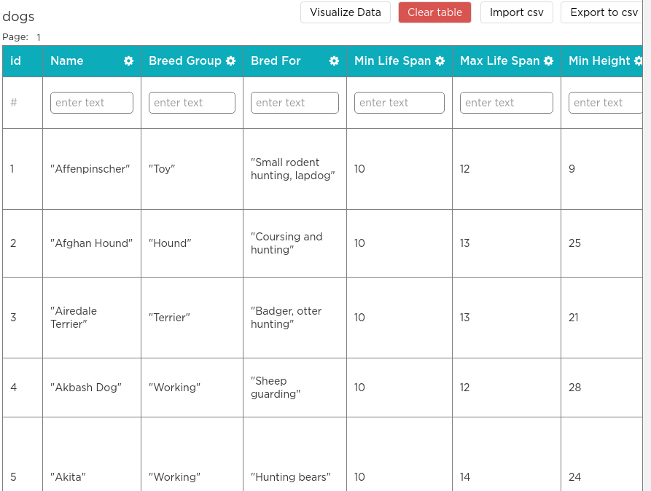

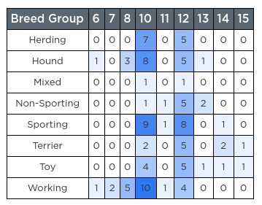

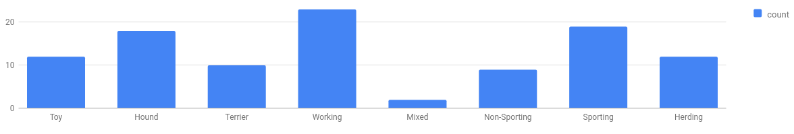
Unit 9 Lesson 2 - Warm Up
The Data Analysis Process
Clean and/or filter
Collect or choose data
Visualize and find patterns
Generate new Information
For the next three lessons we're going to focus on how data is used to make new information. Afterwards we'll start thinking about how this process is useful in many different contexts.

