Slide 1

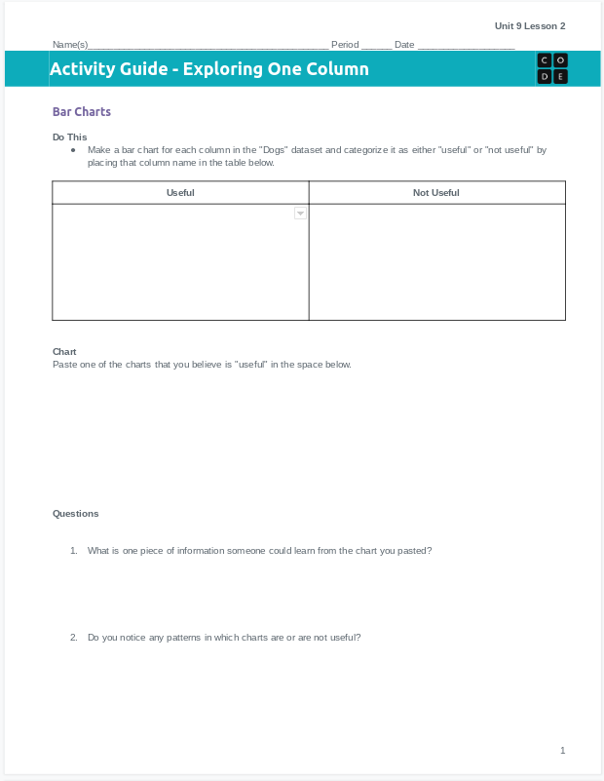
Unit 9 Lesson 2 - Activity
Let's practice making bar charts ourselves!
You'll need your activity guide, ideally in digital form.

