Slide 1

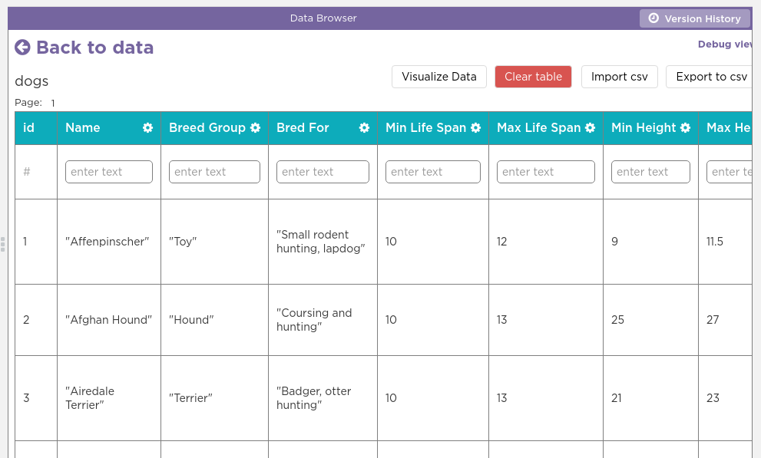
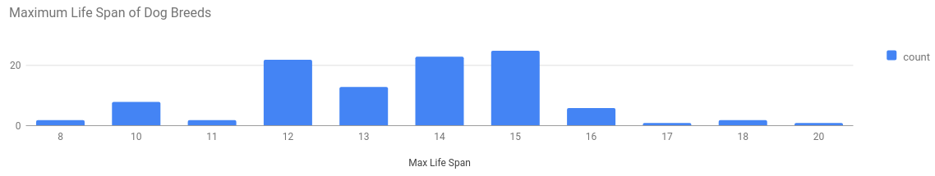
Unit 9 Lesson 2 - Activity
Do This: Make the Dogs Bar Chart
Go to Lesson 2, Level 1
Open the Dogs table in the Data Tab
Open the Data Visualizer
Set the following values
Chart Type: "Bar Chart"
Values: "Maximum Life Span"
Once you've made the chart, help others around you
Click "Visualize Data"

