Slide 1

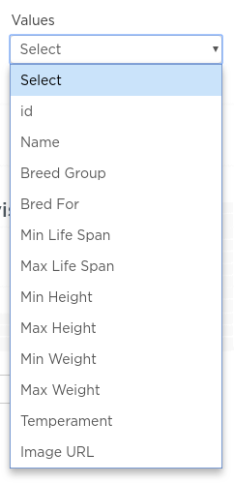
Unit 9 Lesson 2 - Activity
Do This: Fill out page 1 of your activity guide
Make a bar chart for every column in the Dogs table and decide if the chart is "useful" or "not useful"
Paste one of the charts you think is "useful" into your activity guide
Answer the questions at the bottom

