Slide 1

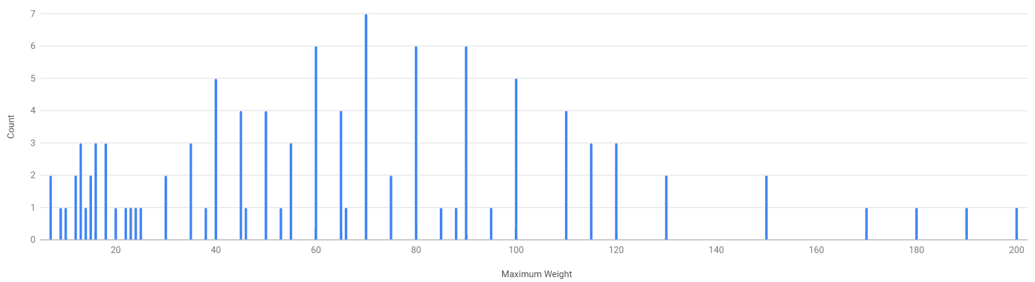
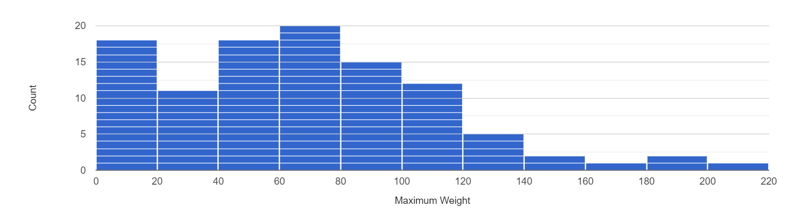
Unit 9 Lesson 2 - Activity
This is the bar chart for "Max Weight." It's a little difficult to read
In the Visualizer, make a "Histogram" for "Max Weight" with a "Bucket Size" of 20
Prompt: Which of these makes it easier to understand the data? What do you think the "histogram" is doing to visualize the data differently?

