Slide 1

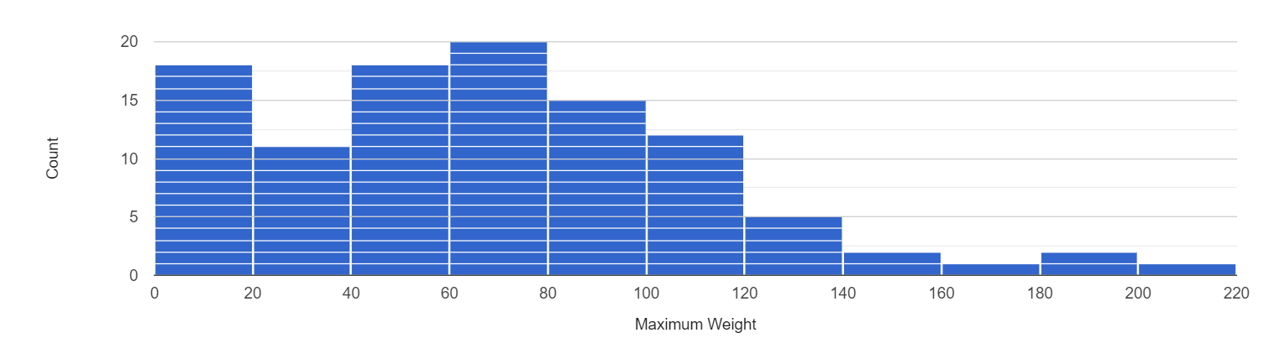
Unit 9 Lesson 2 - Activity
Histogram: Similar to a bar chart, but first all numbers in a range or "bucket" are grouped together. For example, the chart below has a bucket size of 20 so the numbers 41, 48, and 53 would all be placed in the same bucket between 40 and 60.
Histograms can only be created with numeric data but can be useful when a normal bar chart may be difficult to read.
Information we can get out of histograms:
What range of value(s) are most common in this column?
What range value(s) are least common in this column?
What ranges of values do or do not appear in this column?

