Slide 1

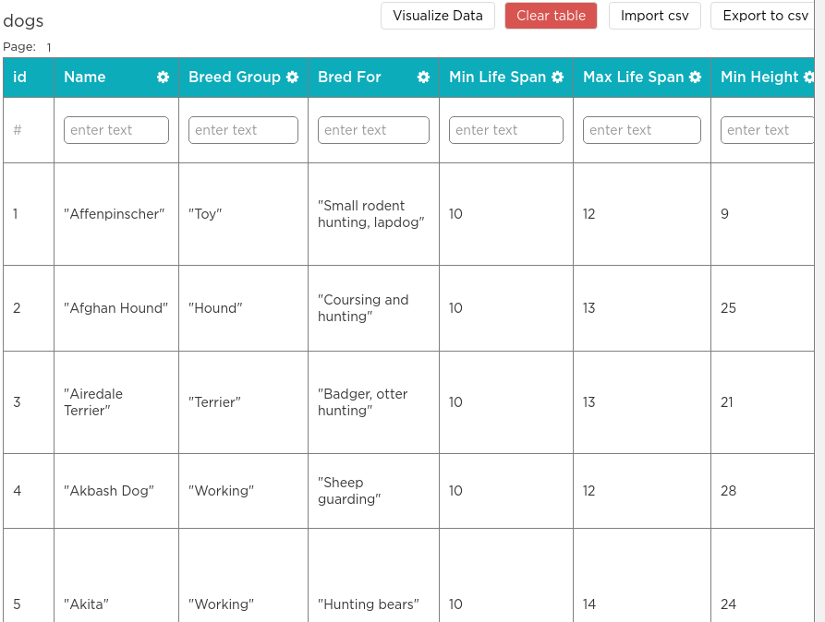

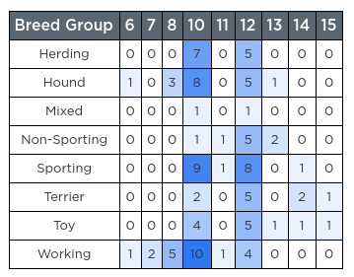

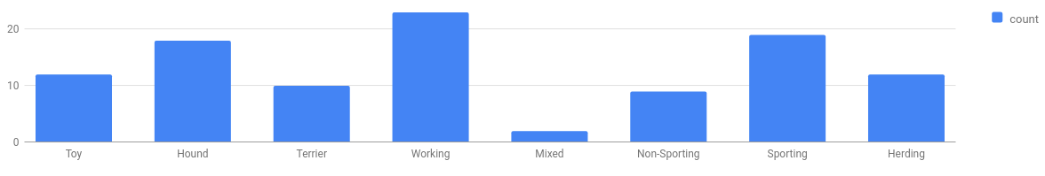
Unit 9 Lesson 2 - Wrap Up
The Data Analysis Process
Clean and/or Filter
Collect or Choose Data
Visualize and Find Patterns
New Information
Prompt: Which steps of the Data Analysis Process did you see in today's activity? Where did you see them? Hint: There's one step we didn't do at all!

