Slide 1

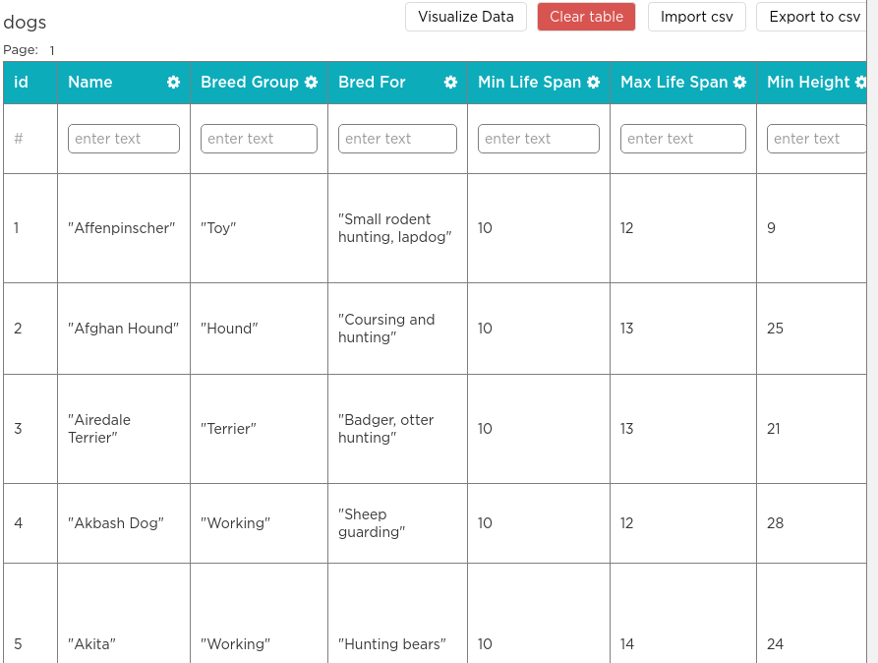
Unit 9 Lesson 3 - Warm Up
Imagine you have used a survey to collect information from students.
All of that data is now stored in a table. You are excited to dig into the data and see what you can learn. Let's go! | ???
Collect or Choose Data

